Slide 1

Section 2.7
Free falling

Slide 2
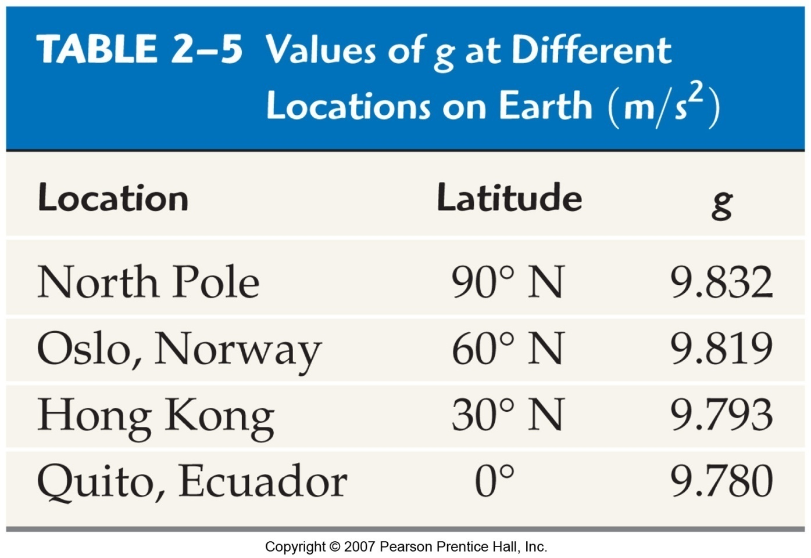
2-7 Freely Falling Objects
Free fall is the motion of an object subject only to the influence of gravity. The acceleration due to gravity is a constant, g.

Slide 3
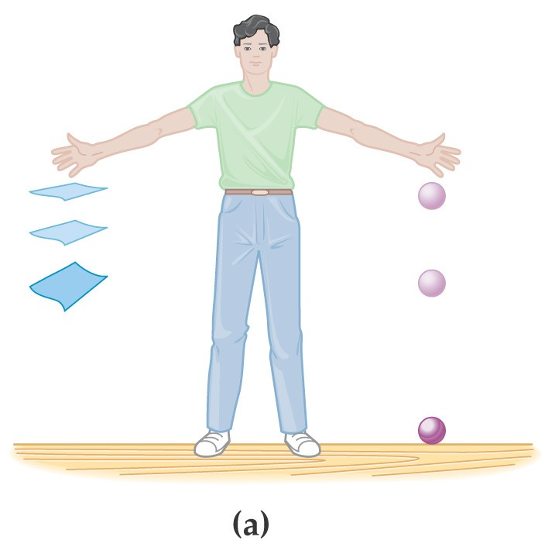
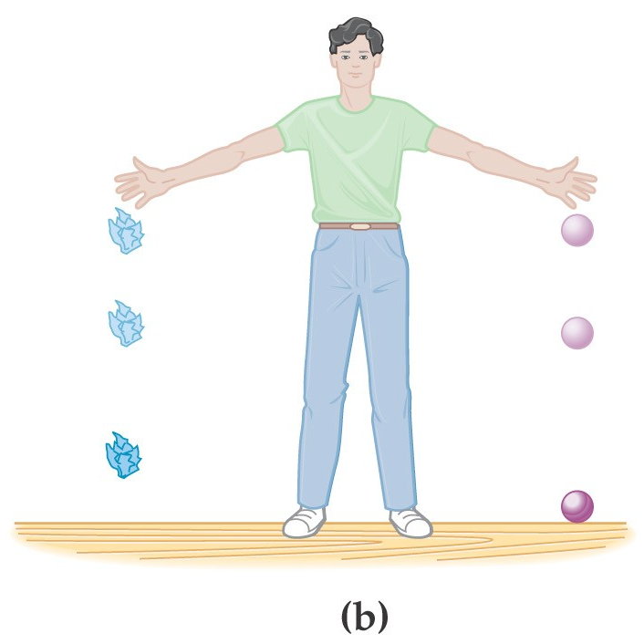
2-7 Freely Falling Objects
An object falling in air is subject to air resistance (and therefore is not freely falling).

Slide 4
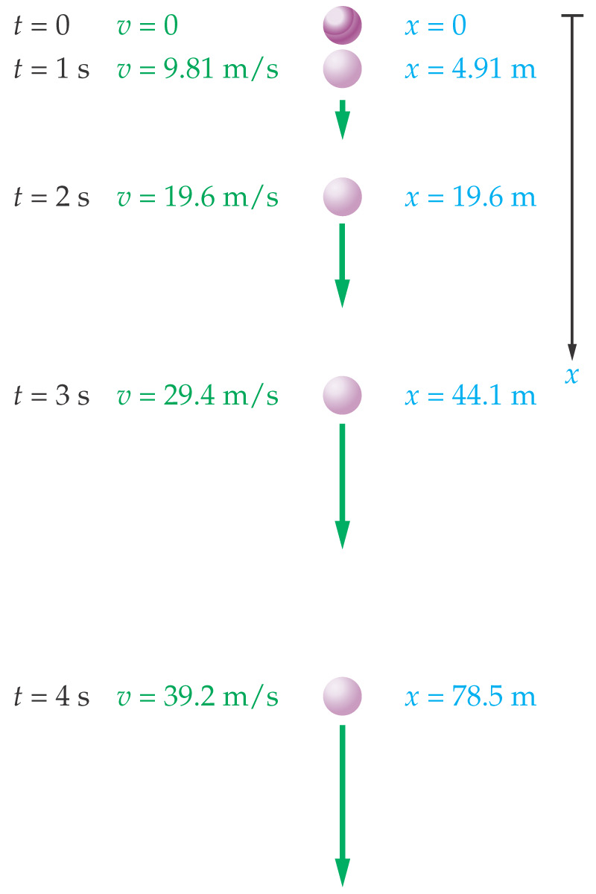
2-7 Freely Falling Objects
Free fall from rest:

Slide 5

Consider a cat on a
balance beam…
P
t
An object is in free fall if the “only” force acting on it is gravity.
v
0
t
a
a = g = –9.81 m/s²
0
t

Slide 6
Free Fall
An alarm clock is “fire-escaped”
from rest from height 38.0 m
a. How long is clock in the air?
= 2.78 s

Slide 7
b. Find velocity of clock at impact.
0
c. Find velocity of clock halfway down.
v_{f} = –19.3 m/s

Slide 8
A full beverage can is launched upward with initial velocity 22.8 m/s. Find…
a. …time to get to the top
b. …total time in air

Slide 9
c. …maximum height attained
(–) sign because
g is and Δy is
d. …location of can when its speed
is half its original speed

Slide 10
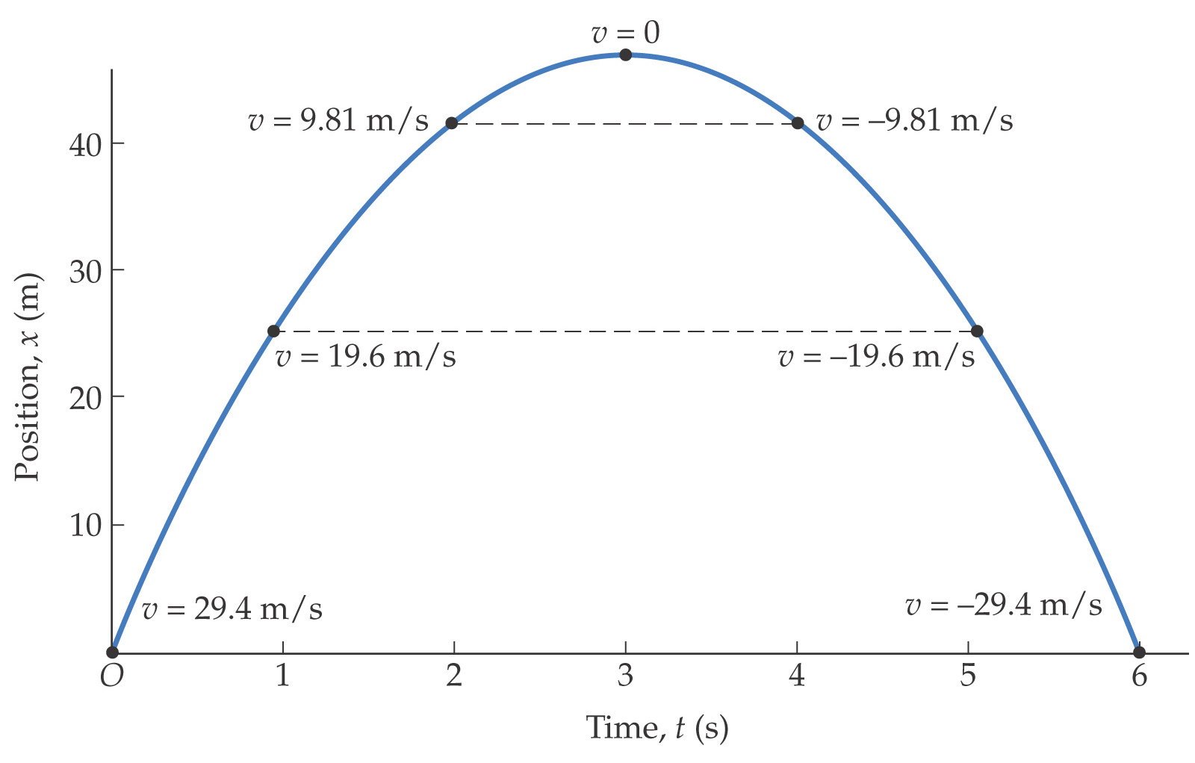
2-7 Freely Falling Objects
Trajectory of a projectile:

Slide 11
Summary of Chapter 2
Distance: total length of travel
Displacement: change in position
Average speed: distance / time
Average velocity: displacement / time
Instantaneous velocity: average velocity measured over an infinitesimally small time

Slide 12
Summary of Chapter 2
Instantaneous acceleration: average acceleration measured over an infinitesimally small time
Average acceleration: change in velocity divided by change in time
Deceleration: velocity and acceleration have opposite signs
Constant acceleration: equations of motion relate position, velocity, acceleration, and time
Freely falling objects: constant acceleration
g = 9.81 m/s²

