Slide 1

2-4 Acceleration
Average acceleration:
(2-5)

Slide 2
acceleration:
“how quickly” velocity is changing
-- speed up
-- slow down
-- change direction
unit →

Slide 3
Car traveling 65 m/s
approaches stop sign.
Driver applies brakes
for 8.2 s. Find car’s
acceleration.
(car goes 7.9 m/s slower each second for 8.2 s)

Slide 4
Car traveling 65 m/s
slams into tree and
stops in 0.15 s
Find car’s (and driver’s)
acceleration.
Speed doesn’t kill.
Rate-of-change-of-speed
(i.e., acceleration) kills.

Slide 5
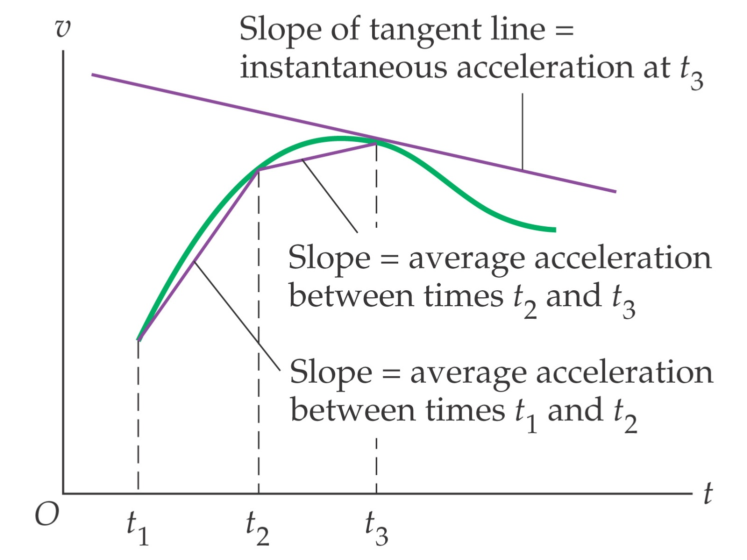
2-4 Acceleration
Graphical Interpretation of Average and Instantaneous Acceleration:

Slide 6
Consider the following v-t curve.
10
5
v (m/s)
0
-5
-10
t (s)
0
1
2
3
4
5
6
7
8
Slope of a v-t curve at any time is object’s acceleration at that time.
slope of curve is:

Slide 7
Consider the following a-t curve.
2
1
a (m/s²)
0
-1
-2
t (s)
0
1
2
3
4
5
6
If the object starts at
rest, the associated
v-t curve looks like…
6
4
v (m/s)
2
0
0
1
2
3
4
5
6
t (s)

Slide 8
Find object’s average velocity.
6
4
v (m/s)
2
0
0
1
2
3
4
5
6
t (s)

Slide 9
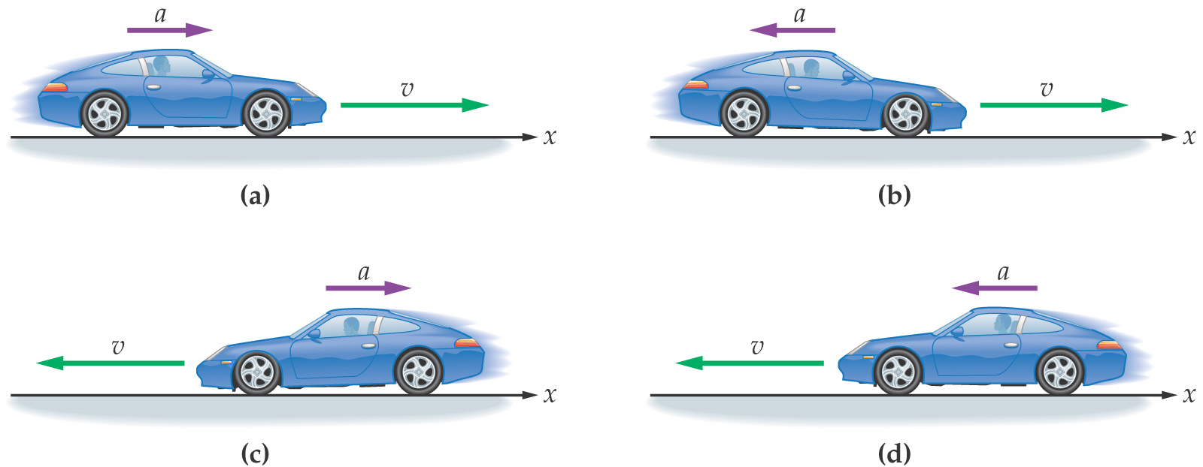
2-4 Acceleration
Acceleration (increasing speed) and deceleration (decreasing speed) should not be confused with the directions of velocity and acceleration:

