Slide 1
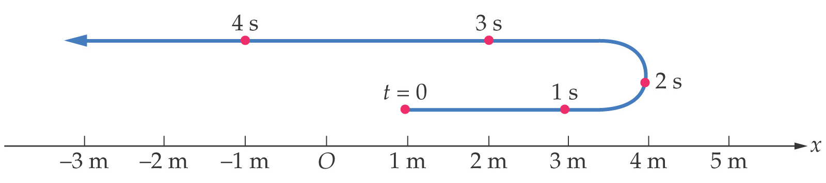

Chapter 2
One-Dimensional Kinematics

Slide 2
Units of Chapter 2
Position, Distance, and Displacement
Average Speed and Velocity
Instantaneous Velocity
Acceleration
Motion with Constant Acceleration
Applications of the Equations of Motion
Freely Falling Objects

Slide 3
Review - Introductory Concepts
scalar
vector
magnitude, units
magnitude, units, direction
e.g.,
e.g.,
mass (25 kg)
weight (140 lbs. )
temperature (83 K)
force (48 N )

Slide 4
distance (d)
displacement (Δx or Δy)
the difference between
the starting and ending
points
how far object travels
-- depends on
path taken
-- independent of
path taken
Cleveland
Boston
displacement
vector
Memphis

Slide 5
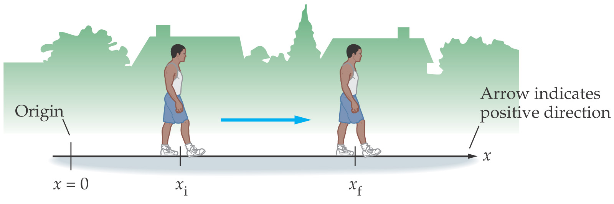
2-1 Position, Distance, and Displacement
Before describing motion, you must set up a coordinate system – define an origin and a positive direction. Distance = d; Displacement = x

Slide 6
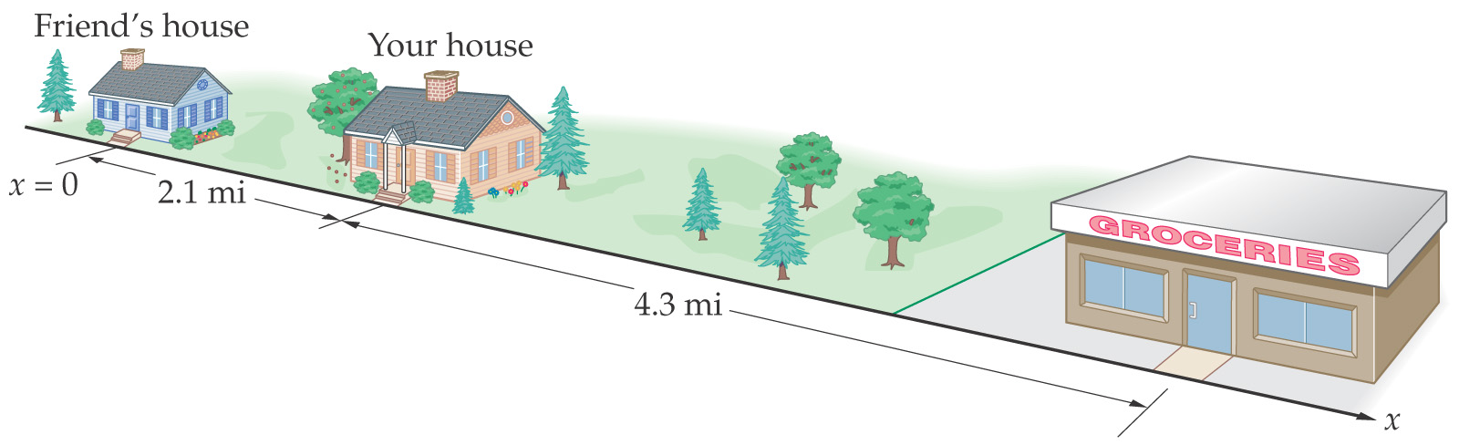
2-1 Position, Distance, and Displacement
The distance is the total length of travel.
If you drive from your house to the grocery store and back, you have covered a distance of 8.6 mi.

Slide 7
2-1 Position, Distance, and Displacement
If you drive from your house to the grocery store and then to your friend’s house, your displacement is 2.1 mi and the distance you have traveled is 10.7 mi.
Displacement is the change in position.

Slide 8
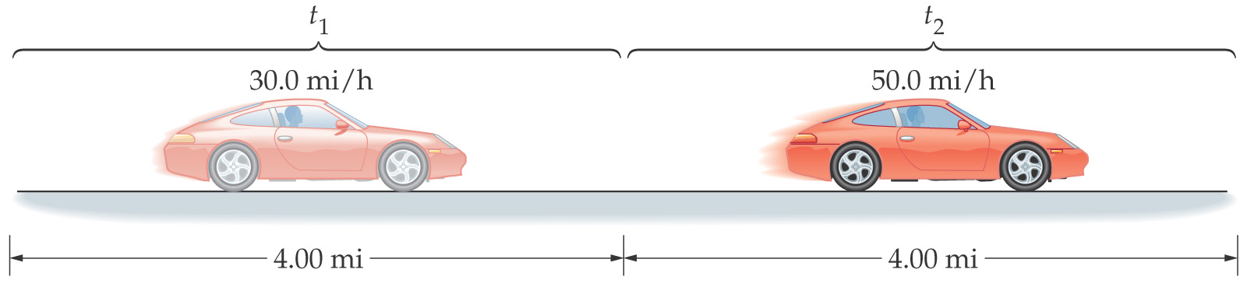
2-2 Average Speed and Velocity
The average speed is defined as the distance traveled divided by the time the trip took:
Average speed = distance / elapsed time
Is the average speed of the red car 40.0 mi/h, more than 40.0 mi/h, or less than 40.0 mi/h?

Slide 9
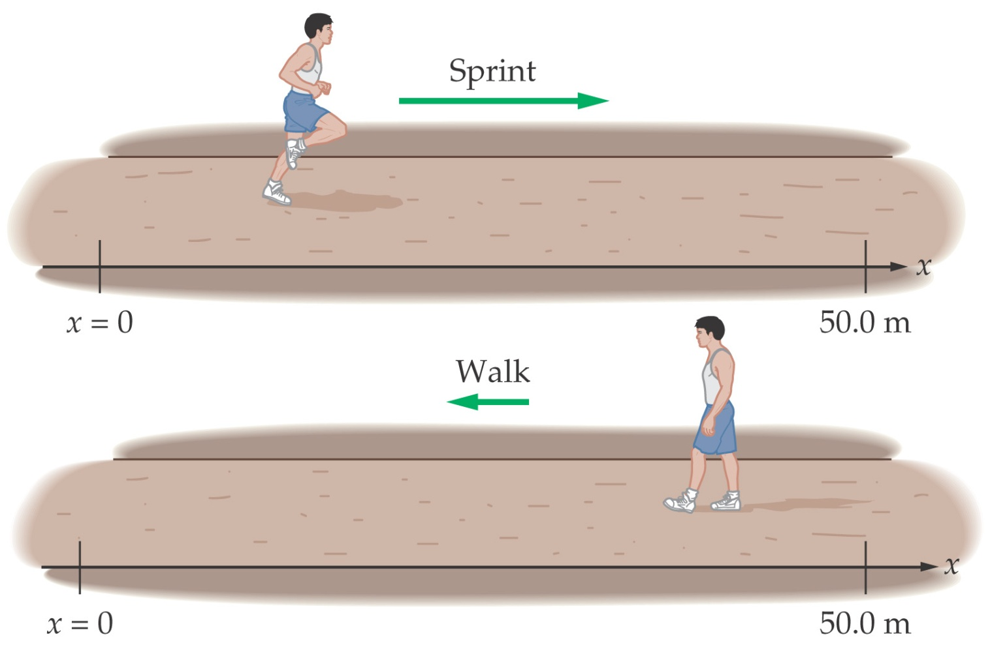
2-2 Average Speed and Velocity
Average velocity = displacement / elapsed time
If you return to your starting point, your average velocity is zero.

Slide 10
speed (v)
velocity (v)
e.g.,
0.12 m/s
e.g.,
0.023 m/s east
x₁,t₁
x₃,t₃
x₂,t₂
Δx
d₂
d₁

Slide 11
An Indy car takes 45.7 s
to go once around the
2.50-mile track at the
Indy 500. Find the…
a) …distance traveled.
2.50 mi
b) …displacement of the car.
0 mi
c) …average speed, in mph.
(
)
3600 s
= 197 mph
1 h
d) …average velocity, in mph.
0 mph

Slide 12
Graphical Analysis of 1-D Motion
Consider the following position-time curve.
15
10
position (m)
5
0
0
1
2
3
4
5
6
7
time (s)
Slope of a P-t curve at any time is object’s v at that time.
slope of curve is:

Slide 13
Find object’s velocity at
t = 2.0 s and at t = 6.5 s.
**Remember rise/run
15
10
position (m)
5
0
0
1
2
3
4
5
6
7
time (s)
(–) sign indicates that the object is moving opposite to how it started
(which we assumed was the (+) direction).

Slide 14
instantaneous velocity:
e.g., police radar
constant speed:
e.g., cruise control
constant velocity:
constant speed in a straight line

Slide 15
2-3 Instantaneous Velocity
Definition:
(2-4)
This means that we evaluate the average velocity over a shorter and shorter period of time; as that time becomes infinitesimally small, we have the instantaneous velocity.

Slide 16
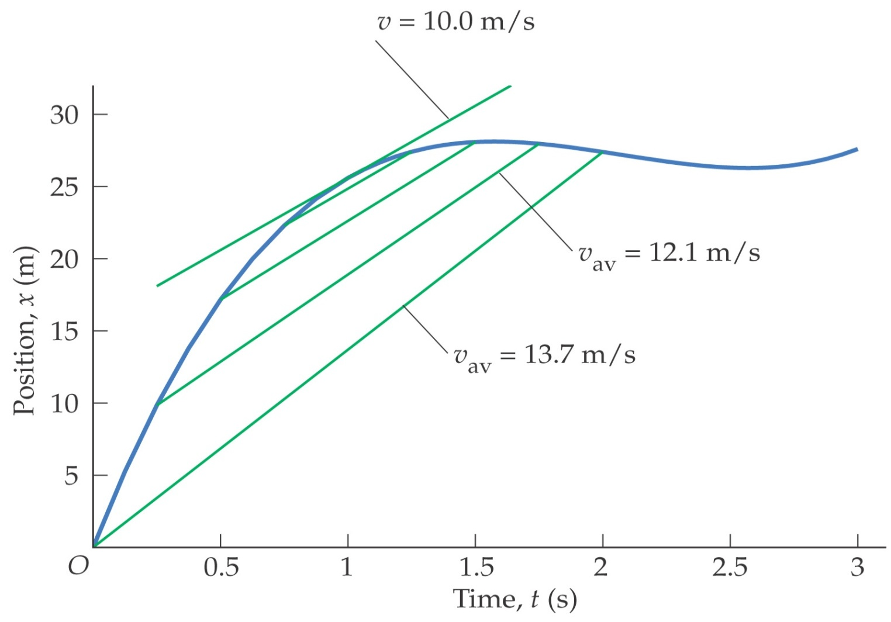
2-3 Instantaneous Velocity
This plot shows the average velocity being measured over shorter and shorter intervals. The instantaneous velocity is tangent to the curve.

Slide 17
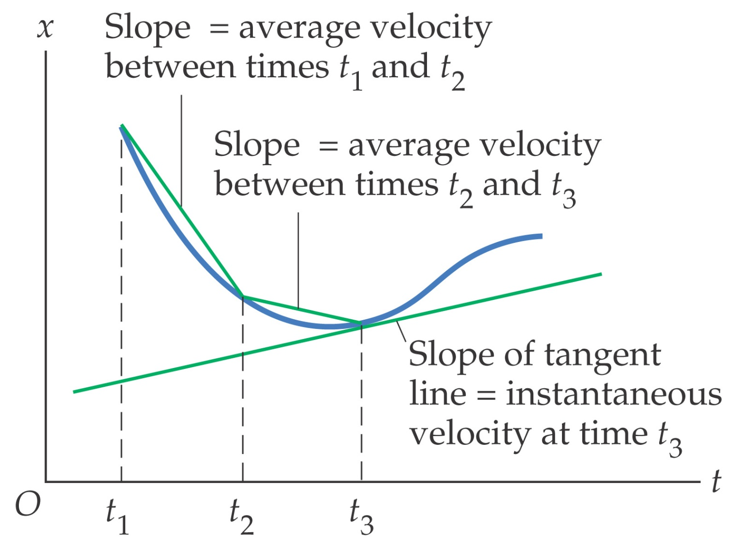
2-3 Instantaneous Velocity
Graphical Interpretation of Average and Instantaneous Velocity

