Slide 1
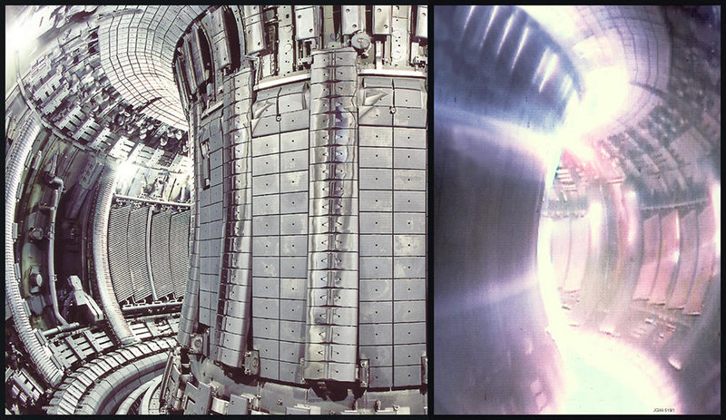
Magnetism
magnetic field (B):
generated by moving
electric charges
-- Magnets have a north and south pole.
ATTRACTIVE REPULSIVE
N
S
N
N
S
S
A tokamak is a machine that
generates a B field to confine
a plasma for fusion research.

Slide 2
Earth acts like a big magnet.
--
convection currents
in molten core
true north:
S
geographic north
magnetic north:
the direction a
compass points
(i.e., the S pole
of the Earth-magnet)
N
magnetic declination:
the difference between true and magnetic north
(depends on one’s global location)

Slide 3
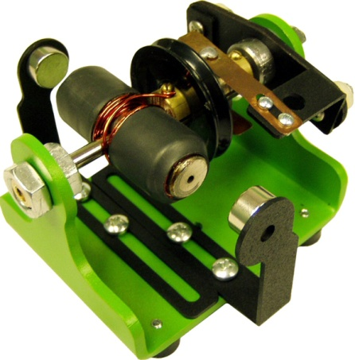

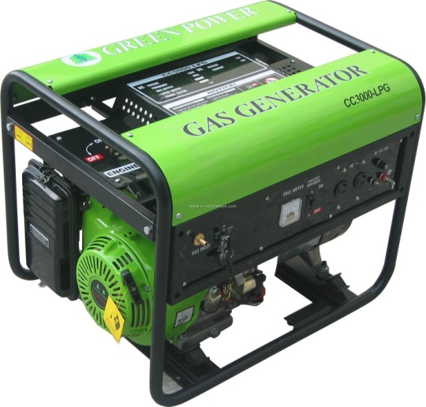
motor:
electric
current
magnetic
field
mechanical
energy
I x B F
generator:
mechanical
energy
magnetic
field
electric
current
F x B I

Slide 4
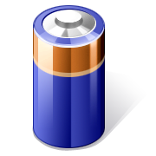
two types of current:
direct current (DC) alternating current (AC)
current flows
in one direction
current flows
back and forth
+I
+I
0
0
–I
–I
e.g.,
batteries
e.g.,
electrical
outlets

Slide 5
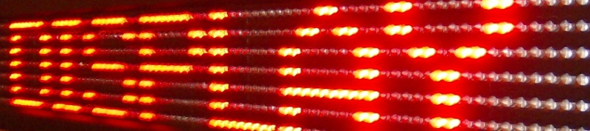
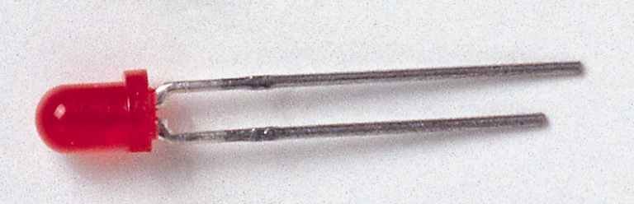
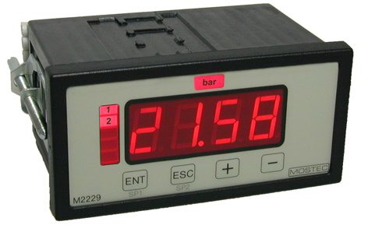
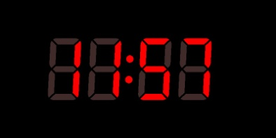
diode: allows current to pass more easily in
one direction than another
--
converts AC to DC
+I
0
–I
The light-emitting diode (LED)
has a wide variety of applications.

Slide 6
Lenz’s Law
With AC, the current in WIRE 1 is constantly changing
in magnitude and direction.
ΔI₁
This causes B field in WIRE 1
to change constantly.
ΔB₁
ΔB₂
ΔI₂
When WIRE 2
– a separate, closed loop – senses WIRE 1’s
changing B field, a current is induced in WIRE 2.
The induced current in WIRE 2 generates its own
B field, which opposes the B field from WIRE 1.
This last statement is called Lenz’s law.

Slide 7
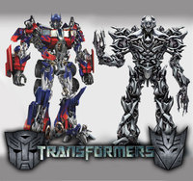
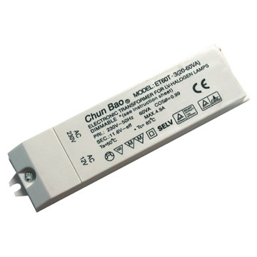
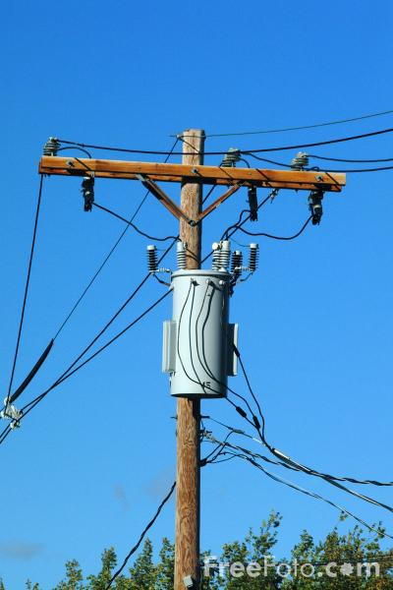
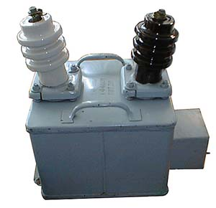
Transformers
A transformer is a device that allows
voltage to be increased or decreased.
-- In order to work, the voltage must be…
changing.
--
For all practical purposes, this requires AC.

Slide 8
A step-up transformer _____________ the voltage;
increases
the secondary has MORE turns than the primary.
insulated
wire 1
insulated
wire 2
iron core
primary secondary
N₁ turns N₂ turns
voltage ΔV₁ voltage ΔV₂
current I₁ current I₂
decreases
A step-down transformer ____________ the voltage;
the secondary has FEWER turns than the primary.

Slide 9
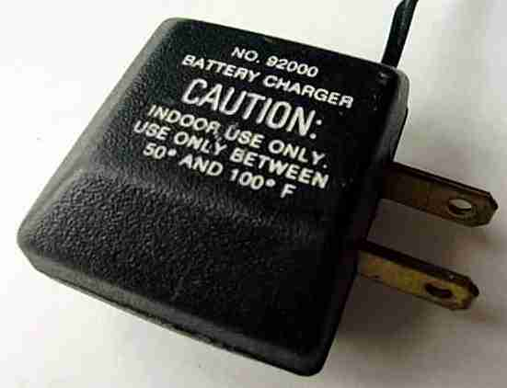
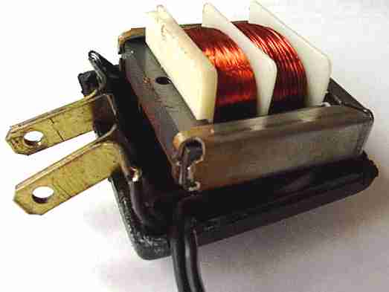
Change in voltage is directly
proportional to ratio of
number of turns:
Change in current is inversely
proportional to change in voltage:
I₁ΔV₁ = I₂ΔV₂
Change in current is inversely
proportional to ratio of
number of turns:
I₁N₁ = I₂N₂

Slide 10
Transformers are used in
transporting electrical power.
HIGH-VOLTAGE
POWER LINES
step-down
transformer
(~2,000 V)
step-down
transformer
(120/220 V)
step-up
transformer
(~150,000 V)
(more efficient, less I²R loss)
POWER
GENERATING
PLANT
RESIDENTIAL
CONSUMER

