Slide 1
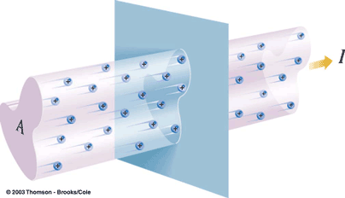
Chapter 21
Electric Current

Slide 2
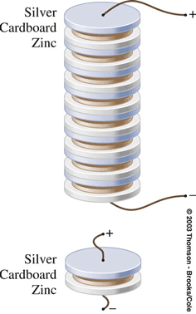
Battery
The Battery
The voltaic pile, in which the elementary cell was a zinc-card-board-silver sandwich.

Slide 3
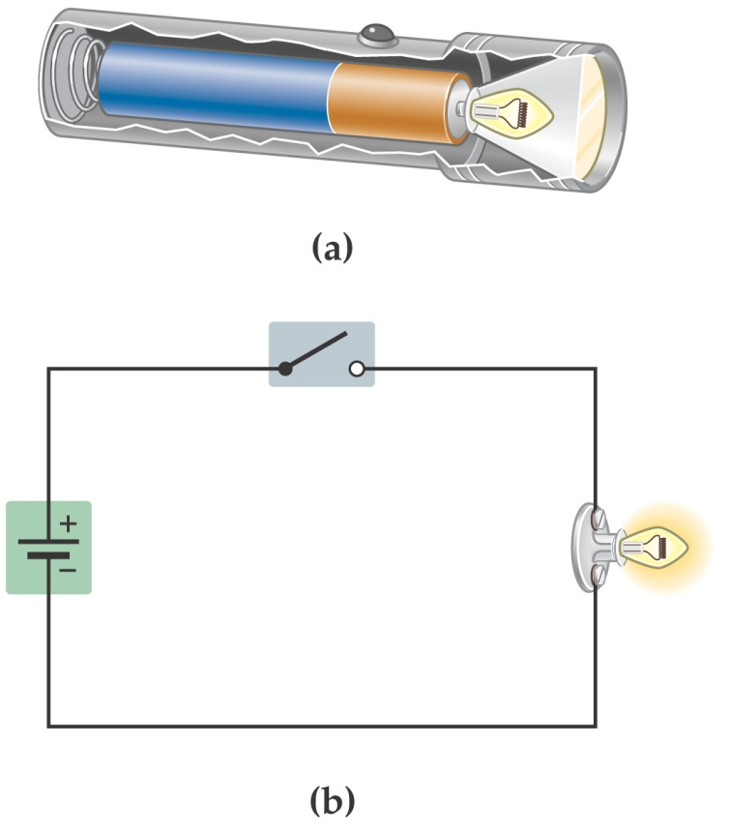
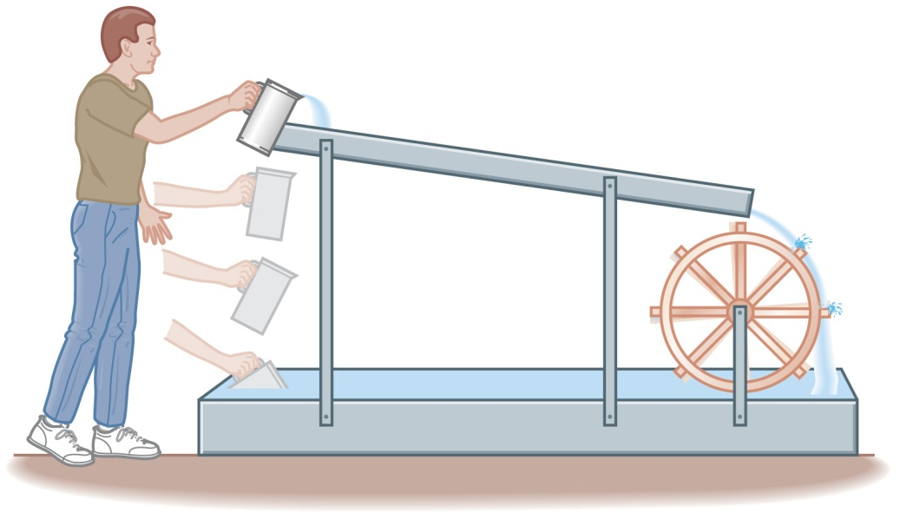
21-1 Electric Current
A battery uses chemical reactions to produce a potential difference between its terminals. It causes current to flow through the flashlight bulb similar to the way the person lifting the water causes the water to flow through the paddle wheel.

Slide 4
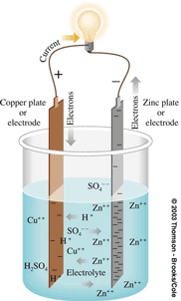
Electromotive Force ε
Electromotive Force: the emf, ε, is the voltage measured across the terminals of a source when no current is being drawn from or delivered to it.

Slide 5

21-1 Electric Current
A battery that is disconnected from any circuit has an electric potential difference between its terminals that is called the electromotive force or emf
Remember – despite its name, the emf is an electric potential, not a force.
The amount of work it takes to move a charge ΔQ from one terminal to the other is:

Slide 6
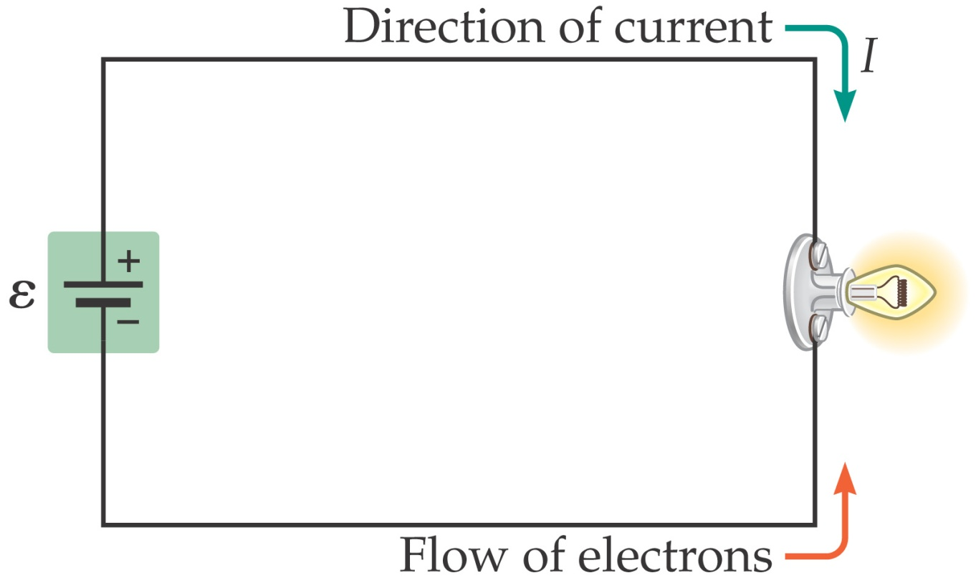
21-1 Electric Current
The direction of current flow – from the positive terminal to the negative one – was decided before it was realized that electrons are negatively charged. Therefore, current flows around a circuit in the direction a positive charge
would move; electrons move the other way. However, this does not matter in most circuits.

Slide 7

21-1 Electric Current
Finally, the actual motion of electrons along a wire is quite slow; the electrons spend most of their time bouncing around randomly, and have only a small velocity component opposite to the direction of the current. (The electric signal propagates much more quickly!)

Slide 8
Electric Current and Circuits
current: the rate of charge flow
(NOT the speed of charge flow)
Amount of Charge Flow | Time of Flow | Rate of Charge Flow
100 charges | 2 s
500 charges | 25 s
50 ch/s
20 ch/s
One equation for current:

Slide 9

5.8 C of charge flow through
a bulb filament in 3.1 s. Find
current flowing through filament.
= 1.9 A
How many e– flow through bulb in one hour?
→ X = 6735.5 C
6735.5 C
= 4.2 x 10²² e–

Slide 10
If 1.0 mole of e– flow through
an appliance in 5.6 hours, find
current pulled by appliance.
6.02 x 10²³ e–
= 96,320 C
= 4.8 A

Slide 11
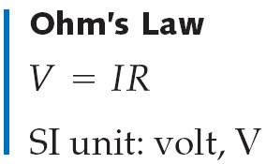
21-2 Resistance and Ohm’s Law
Under normal circumstances, wires present some resistance to the motion of electrons. Ohm’s law relates the voltage to the current:
Be careful – Ohm’s law is not a universal law and is only useful for certain materials (which include most metallic conductors).

Slide 12
Ohm’s Law
Voltage is an electric…
pressure.
L
R
L
L
ΔV
ΔV
ΔV
R
R
R
I
I
I

Slide 13
Equation for Ohm’s law:
R = resistance,
in ohms (W)
R₂
ΔV
ΔV
R
R₁
I
I
ohmic resistor
non-ohmic resistor
--
R constant over a
large range of DV
--
R varies,
depending on DV

Slide 14
Hair dryer w/resistance 280 ohms
is plugged into a standard
outlet. What current flows
through hair dryer?
* memorize: standard outlet = 120 V
= 0.43 A
Suppose hair dryer is plugged into an outlet with
potential difference 220 V. Find current.
= 0.79 A
(you’ll “fry” your
hair dryer)

Slide 15
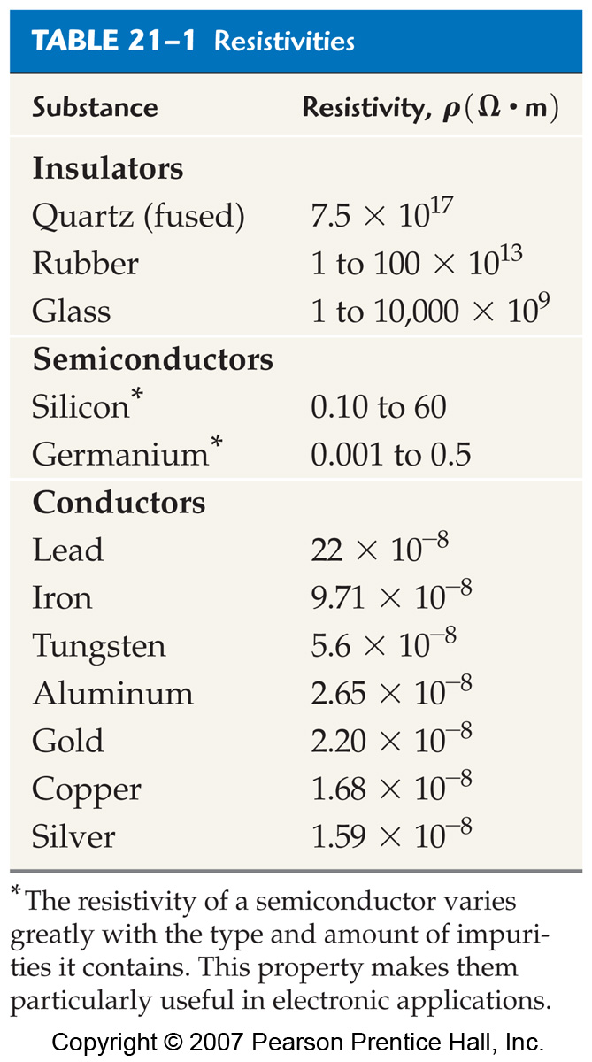
21-2 Resistance and Ohm’s Law
The difference between insulators, semiconductors, and conductors can be clearly seen in their resistivities:

Slide 16
21-2 Resistance and Ohm’s Law
Two wires of the same length and diameter will have different resistances if they are made of different materials. This property of a material is called the resistivity.

Slide 17
21-2 Resistance and Ohm’s Law
In general, the resistance of materials goes up as the temperature goes up, due to thermal effects. This property can be used in thermometers.
Resistivity decreases as the temperature decreases, but there is a certain class of materials called superconductors in which the resistivity drops suddenly to zero at a finite temperature, called the critical temperature T_{C}.

Slide 18
21-3 Energy and Power in Electric Circuits
When a charge moves across a potential difference, its potential energy changes:
Therefore, the power it takes to do this is

Slide 19
21-3 Energy and Power in Electric Circuits
In materials for which Ohm’s law holds, the power can also be written:
This power mostly becomes heat inside the resistive material.

Slide 20
Electric Power
Equation:
P = I ∆V
P = power rating /
power consumed (W)
A microwave has power rating 1.0 x 10³ W.
What current flows through it?
P = I ∆V
= 8.3 A
A refrigerator “pulls” 6.25 A. What is its power rating?
P = I ΔV
= 6.25 A (120 V)
= 750 W

Slide 21

What is the resistance of
a 75 W light bulb?
Since…
= 190 Ω
For a 100 W bulb…
= 140 Ω

Slide 22
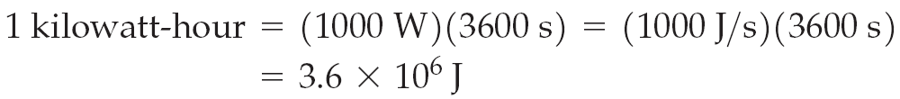
21-3 Energy and Power in Electric Circuits
When the electric company sends you a bill, your usage is quoted in kilowatt-hours (kWh). They are charging you for energy use, and kWh are a measure of energy.

Slide 23
Cost of Electricity
Equation:
COST = POWER x TIME x $RATE
kW h $/kWh
A computer “pulls” 4.0 A and runs constantly.
Electricity costs $0.080/kWh. Find cost to run
computer for one year.
P = IΔV
= 4.0 A (120 V)
= 480 W
= 0.48 kW
TIME = 1 y
= 8760 h
COST =
0.48 kW
(8760 h)
= $340

Slide 24
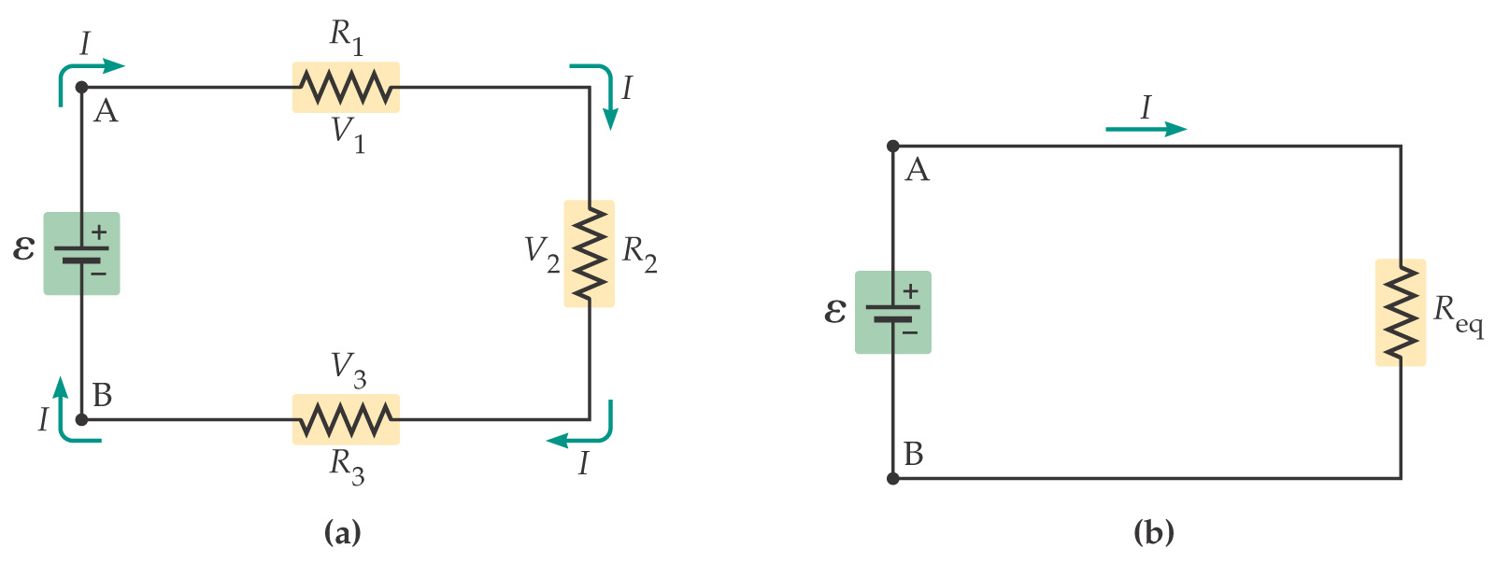
21-4 Resistors in Series and Parallel
Resistors connected end to end are said to be in series. They can be replaced by a single equivalent resistance without changing the current in the circuit.

Slide 25
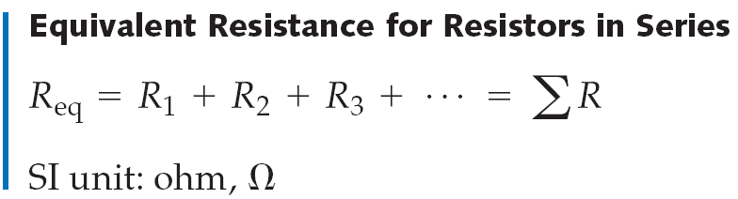
21-4 Resistors in Series and Parallel
Since the current through the series resistors must be the same in each, and the total potential difference is the sum of the potential differences across each resistor, we find that the equivalent resistance is:

Slide 26
ΔV (V)
I (A)
R (Ω)
“24 V”
R₁
“20 V”
Batt.
24
2
12
ΔV
R₂
R₁
4
2
2
R₂
12
2
6
“0 V”
R₃
“8 V”
R₃
8
2
4
ΔV (V)
I (A)
R (Ω)
“15 V”
R₁
“6 V”
Batt.
15
1.5
10
ΔV
R₂
R₁
9
1.5
6
“0 V”
R₂
6
1.5
4
Also for series circuits:
I = I₁ = I₂ = …
ΔV_{batt} = ΔV₁ + ΔV₂ + …

Slide 27
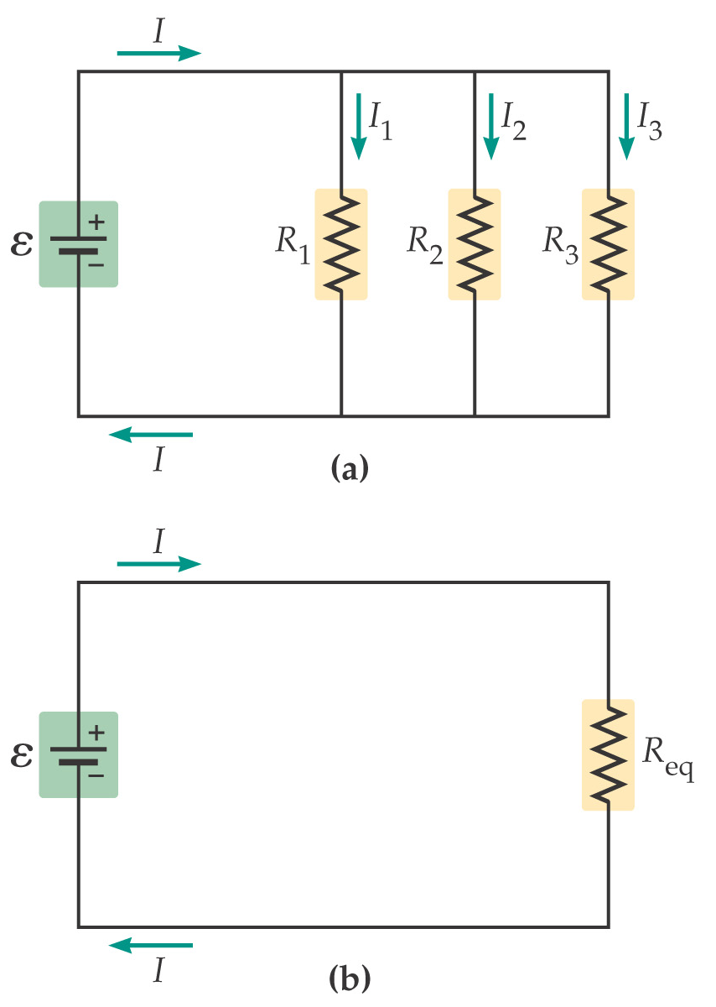
21-4 Resistors in Series and Parallel
Resistors are in parallel when they are across the same potential difference; they can again be replaced by a single equivalent resistance:

Slide 28
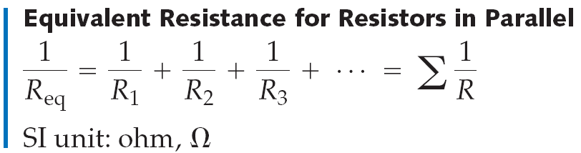
21-4 Resistors in Series and Parallel
Using the fact that the potential difference across each resistor is the same, and the total current is the sum of the currents in each resistor, we find:
Note that this equation gives you the inverse of the resistance, not the resistance itself!

Slide 29
Parallel Circuits
For parallel circuits:
“12 V”
ΔV (V)
I (A)
R (Ω)
R₁
Batt.
12
6
2
ΔV
R₂
R₁
12
2
6
R₂
12
4
3
“0 V”
I = I₁ + I₂ + …
Also for parallel circuits:
ΔV_{batt} = ΔV₁ = ΔV₂ = …

Slide 30
ΔV
“0 V”
“16 V”
ΔV (V)
I (A)
R (Ω)
8 A
R₁
Batt.
16
16.67
0.96
R₁
16
8
2
R₂
4 A
R₂
16
4
4
R₃
R₃
16
2.67
6
2.67 A
R₄
16
2
8
R₄
2 A
R_{eq} = 0.96 Ω

Slide 31
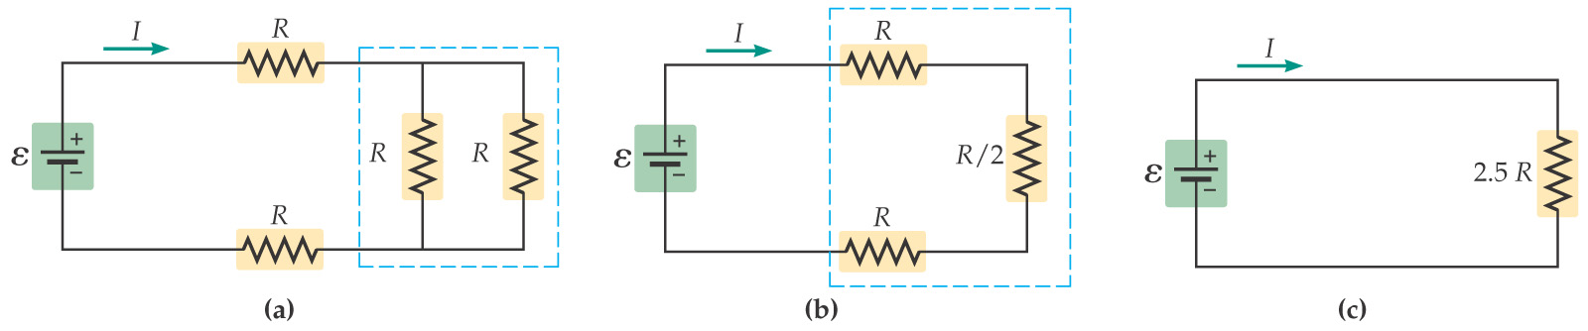
21-4 Resistors in Series and Parallel
If a circuit is more complex, start with combinations of resistors that are either purely in series or in parallel. Replace these with their equivalent resistances; as you go on you will be able to replace more and more of them.

Slide 32
Combination Circuits
Solve the following problems.
R_{eq} = 4 Ω
R₁
“24 V”
“12 V”
ΔV (V)
I (A)
R (Ω)
R₂
Batt.
24
3
8
R₁
12
1.5
8
ΔV
R₂
12
1.5
8
R₃
3 A
3 A
R₃
12
3
4
“0 V”

Slide 33
3.68 Ω
1.85 Ω
ΔV (V)
I (A)
R (Ω)
R₁
“27.3 V”
Batt.
36
2.35
15.31
“36 V”
R₂
R₁
8.7
1.34
6.5
R₂
8.7
1.02
8.5
R₃
4.3
1.02
4.2
R₃
R₄
R₅
R₄
4.3
0.90
4.8
ΔV
R₅
4.3
0.41
10.6
“23 V”
R₆
R₆
17.63
2.35
7.5
R₇
R₇
5.37
0.94
5.7
R₈
R₈
5.37
1.41
3.8
“0 V”
“5.37 V”
R_{eq} = 3.68 + 1.85 + 7.5 + 2.28
2.28 Ω
R_{eq} = 15.31 Ω

Slide 34
2.14 Ω
ΔV (V)
I (A)
R (Ω)
R₂
Batt.
25
“8.68 V”
2.89
8.64
R₃
R₁
10.12
2.89
3.5
“14.88 V”
R₂
6.20
1.13
5.5
“6.28 V”
R₃
6.20
1.77
3.5
R₁
R₄
8.68
1.93
4.5
R₅
“25 V”
R₅
2.40
0.96
2.5
R₄
ΔV
R₆
6.24
0.96
6.5
R₆
3.00 Ω
“0 V”
R_{eq} = 3.5 + 2.14 + 3
R_{eq} = 8.64 Ω

Slide 35
ΔV (V)
I (A)
R (Ω)
R₁
Batt.
12
2.58
4.66
R₂
R₃
R₄
R₁
6.84
0.86
8
R₂
2.02
0.202
10
R₅
R₆
R₃
2.42
0.202
12
R₇
R₄
2.42
0.202
12
“5.16 V”
R₅
3.80
0.38
10
“12 V”
R₈
R₆
3.04
0.38
8
ΔV
R₇
6.84
1.14
6
“0 V”
R₈
5.16
2.58
2
R_{eq,1-7} = 2.66 Ω

Slide 36
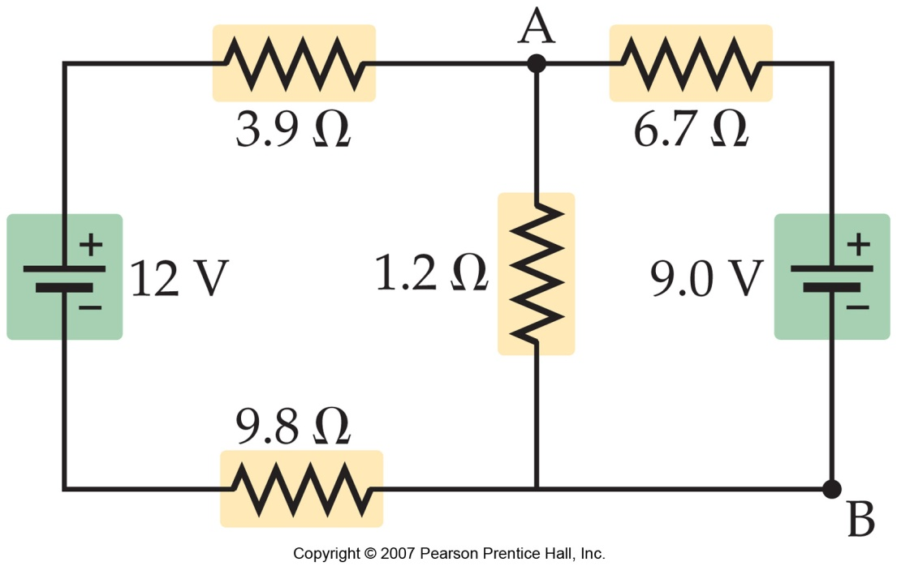
21-5 Kirchhoff’s Rules
More complex circuits cannot be broken down into series and parallel pieces.
For these circuits, Kirchhoff’s rules are useful.
The junction rule is a consequence of charge conservation; the loop rule is a consequence of energy conservation.

Slide 37
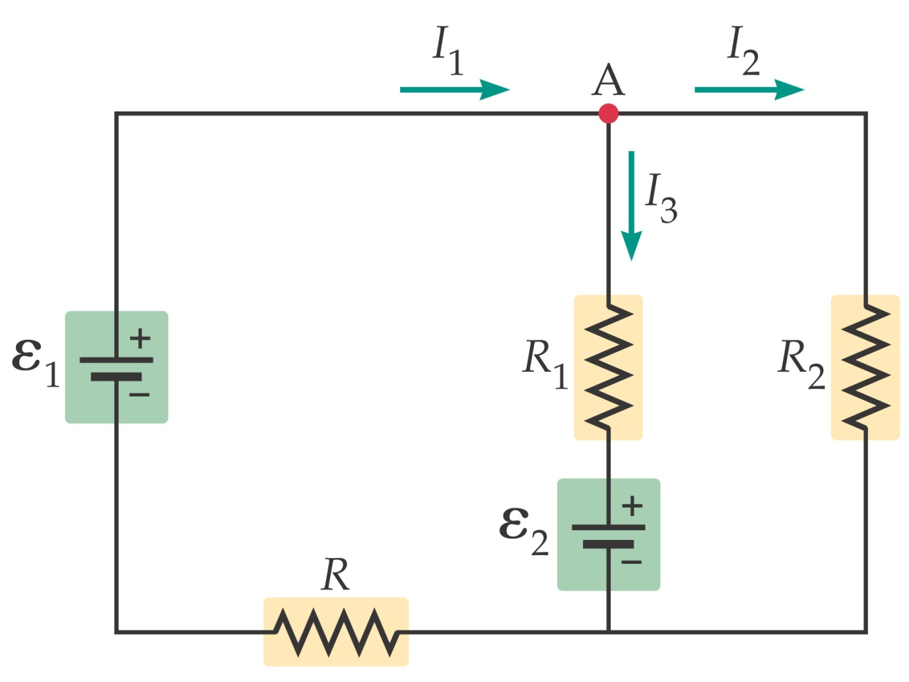

21-5 Kirchhoff’s Rules
The junction rule: At any junction, the current entering the junction must equal the current leaving it.

Slide 38
21-5 Kirchhoff’s Rules
Using Kirchhoff’s rules:
The variables for which you are solving are the currents through the resistors.
You need as many independent equations as you have variables to solve for.
You will need both loop and junction rules.

Slide 39
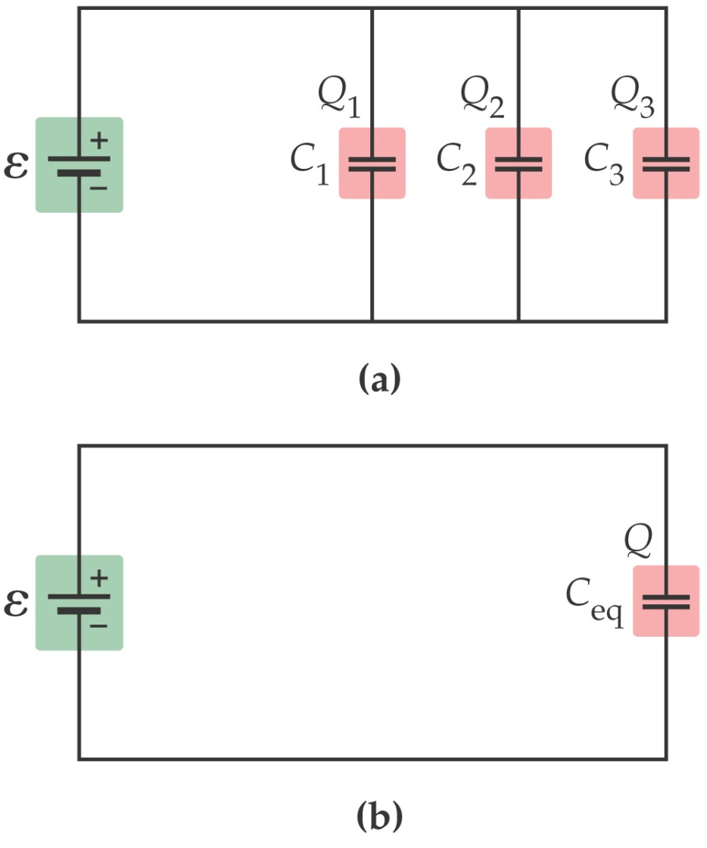
21-6 Circuits Containing Capacitors
Capacitors can also be connected in series or in parallel.
When capacitors are connected in parallel, the potential difference across each one is the same.

Slide 40
21-6 Circuits Containing Capacitors
Therefore, the equivalent capacitance is the sum of the individual capacitances:

Slide 41
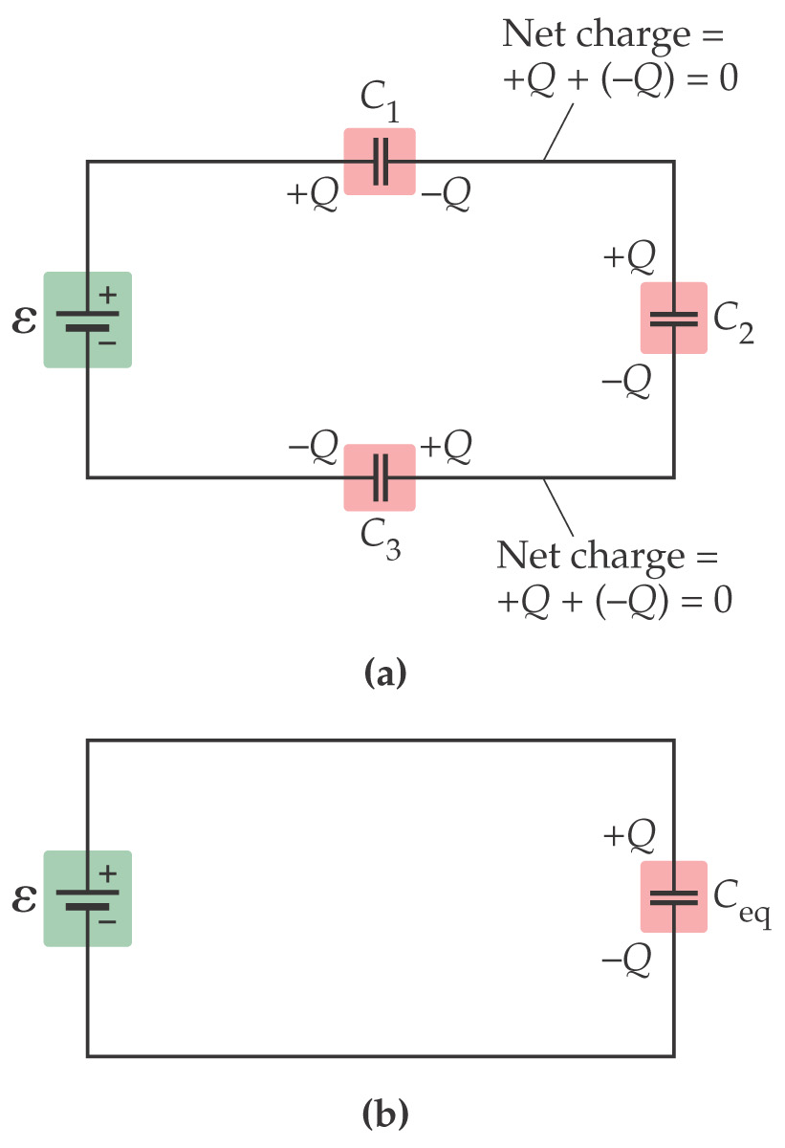
21-6 Circuits Containing Capacitors
Capacitors connected in series do not have the same potential difference across them, but they do all carry the same charge. The total potential difference is the sum of the potential differences across each one.

Slide 42
21-6 Circuits Containing Capacitors
Therefore, the equivalent capacitance is
Note that this equation gives you the inverse of the capacitance, not the capacitance itself!
Capacitors in series combine like resistors in parallel, and vice versa.

Slide 43
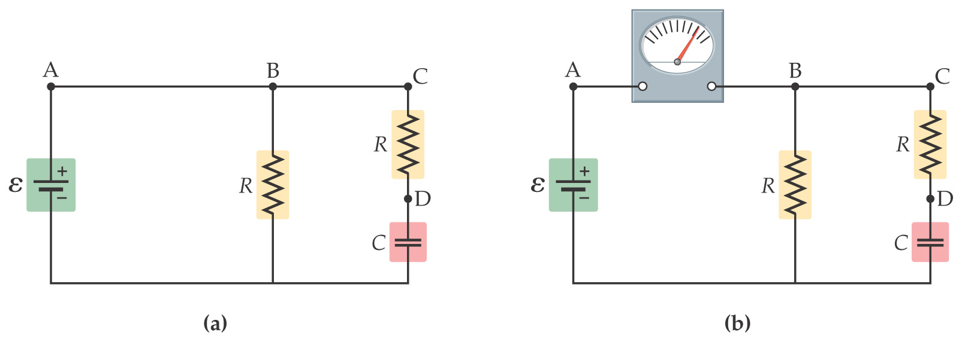
21-8 Ammeters and Voltmeters
An ammeter is a device for measuring current, and a voltmeter measures voltages.
The current in the circuit must flow through the ammeter; therefore the ammeter should have as low a resistance as possible, for the least disturbance.

Slide 44
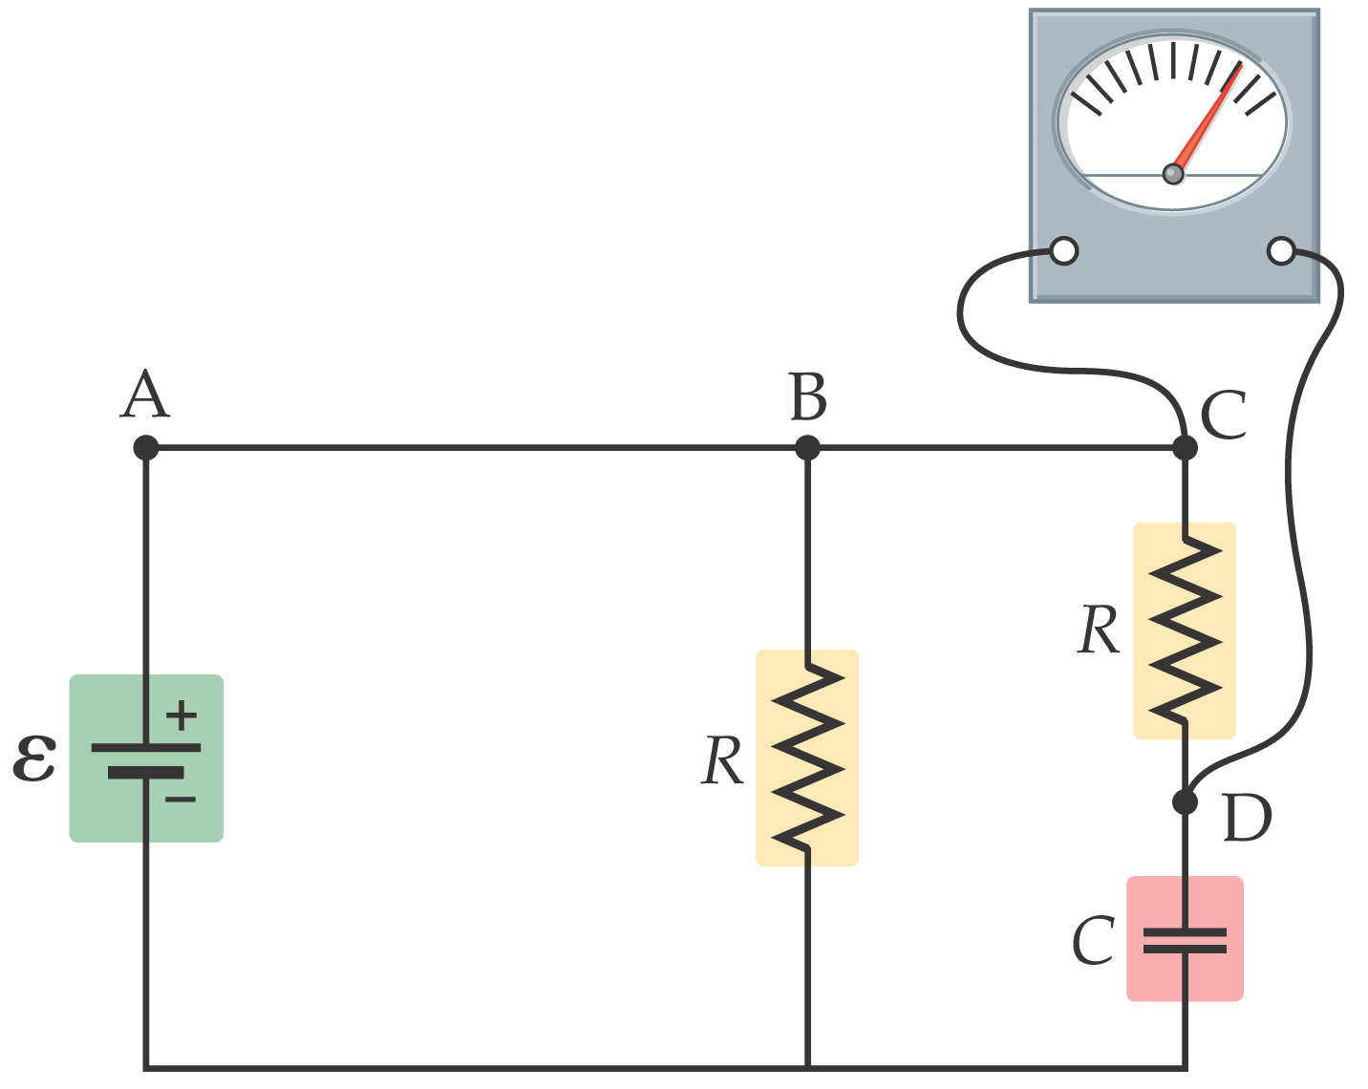
21-8 Ammeters and Voltmeters
A voltmeter measures the potential drop between two points in a circuit. It therefore is connected in parallel; in order to minimize the effect on the circuit, it should have as large a resistance as possible.

Slide 45

ammeter: measures..
TARGET
CIRCUIT
current
low resistance
high resistance
series
parallel
ammeter →
low resistance; connect in series

Slide 46
voltmeter: measures..
TARGET
CIRCUIT
potential difference
low resistance
high resistance
series
parallel
voltmeter →
high resistance; connect in parallel

