Slide 1
18.2
Electromagnetic Spectrum

Slide 2
Learning Objectives Section 18.2
Rank and classify electromagnetic waves based on their frequencies and wavelengths.
Describe the uses for different waves of the electromagnetic spectrum.

Slide 3
What are waves of the spectrum
The electromagnetic spectrum includes:
radio waves
Microwaves
infrared rays
visible light
ultraviolet rays
X-rays
gamma rays

Slide 4
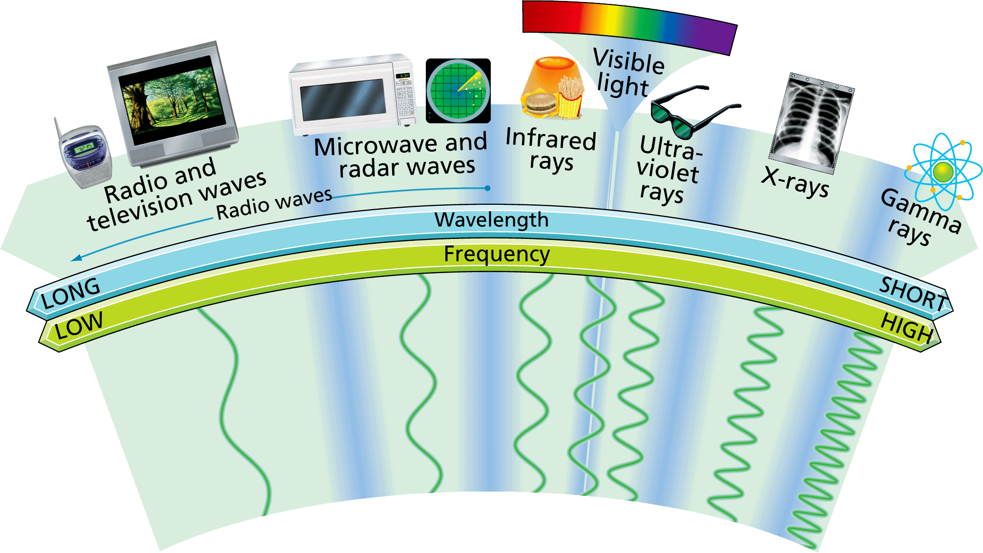
The Waves of the Spectrum
The electromagnetic spectrum consists of radio waves, microwaves, infrared rays, visible light, ultraviolet rays, X-rays, and gamma rays.

Slide 5
Radio Waves & Microwaves
Radio waves are used in radio and television technologies, as well as in microwave ovens and radar.
Radio waves have the longest wavelengths in the electromagnetic spectrum. Wavelengths range from 1 millimeter to as much as thousands of kilometers or longer.
Radio waves also have the lowest frequencies in the spectrum—300,000 megahertz (MHz) or less.

Slide 6
What is the speed of light (all electromagnetic waves)
In a vacuum (absent of anything) – the speed is 3.00 x 10⁸ m/s.

Slide 7
AM & FM Radio
There are two ways that signals are encoded for radio.
In amplitude modulation, the amplitude of the wave is varied. The frequency remains the same. AM radio stations broadcast by amplitude modulation.
In frequency modulation, the frequency of the wave is varied. The amplitude remains the same. FM stations broadcast by frequency modulation.

Slide 8
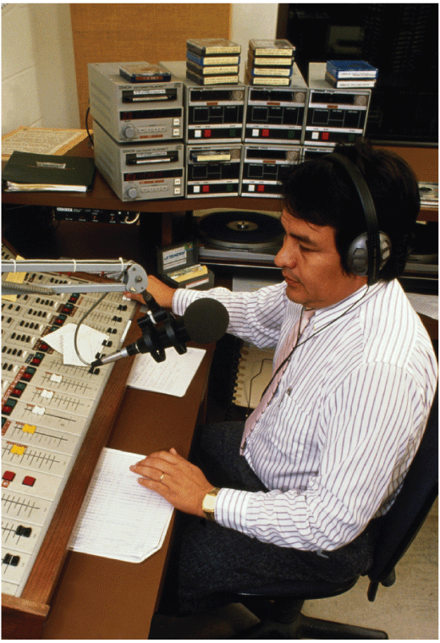
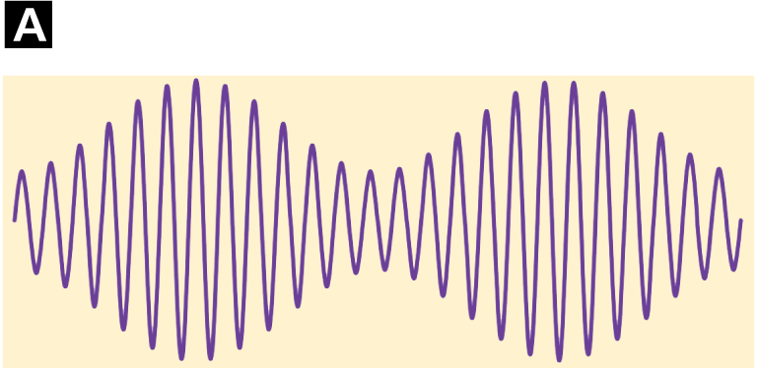
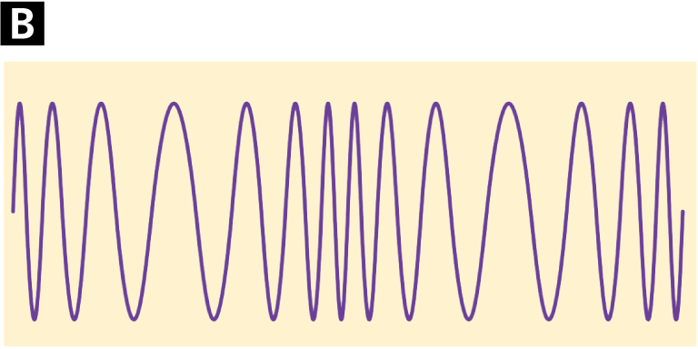
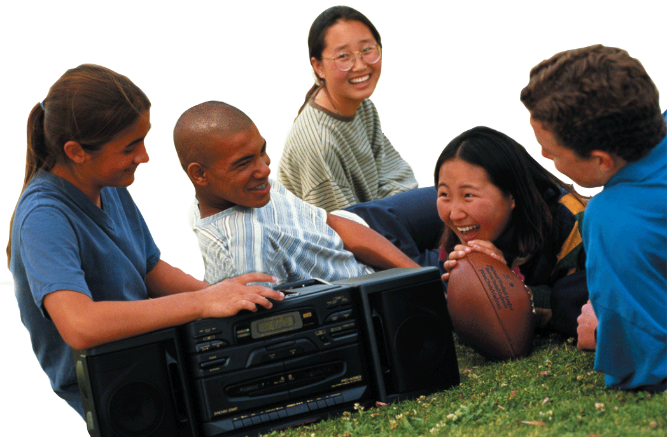
Radio Waves
The announcer’s voice and the music on CD leave the radio studio as electronic signals. Those signals are used to produce a wave with either a varying amplitude or a varying frequency.
AM waves have a varying amplitude.
FM waves have a varying frequency.
Amplitude modulation
Frequency modulation

Slide 9
Microwaves
The shortest-wavelength radio waves are called microwaves. Microwave wavelengths are from about 1 m to about 1 mm.
Frequencies vary from about 300 MHz to about 300,000 MHz.
Microwaves cook and reheat food. Microwaves also carry cell phone conversations. The process works much like a radio broadcast.

Slide 10
Infrared Waves
Infrared rays are used as a source of heat and to discover areas of heat differences
Infrared rays have higher frequencies than radio waves and lower frequencies than red light. Infrared wavelengths vary from about 1 millimeter to about 750 nanometers (10^{–9} meter).
Your skin senses infrared radiation as warmth. Restaurants use infrared lamps to keep foods warm

Slide 11
Infrared Rays
Warmer objects give off more infrared radiation than cooler objects.
A device called a thermograph uses infrared sensors to create thermograms, color-coded pictures that show variations in temperature.
Search-and-rescue teams use infrared cameras to locate people who are trapped during disasters.

Slide 12
Thermograph Images
A thermogram can be used to diagnose problems in a utility line.
When viewed in visible light, the wires all look the same.
The colors in the thermogram image show that the electric current in the center wire is not flowing as it should.

Slide 13
Visible Light
People use visible light to see, to help keep them safe, and to communicate with one another.
The visible part of the electromagnetic spectrum is light that the human eye can see. (ROY G BIV)
Each wavelength in the visible spectrum corresponds to a specific frequency and has a particular color.

Slide 14
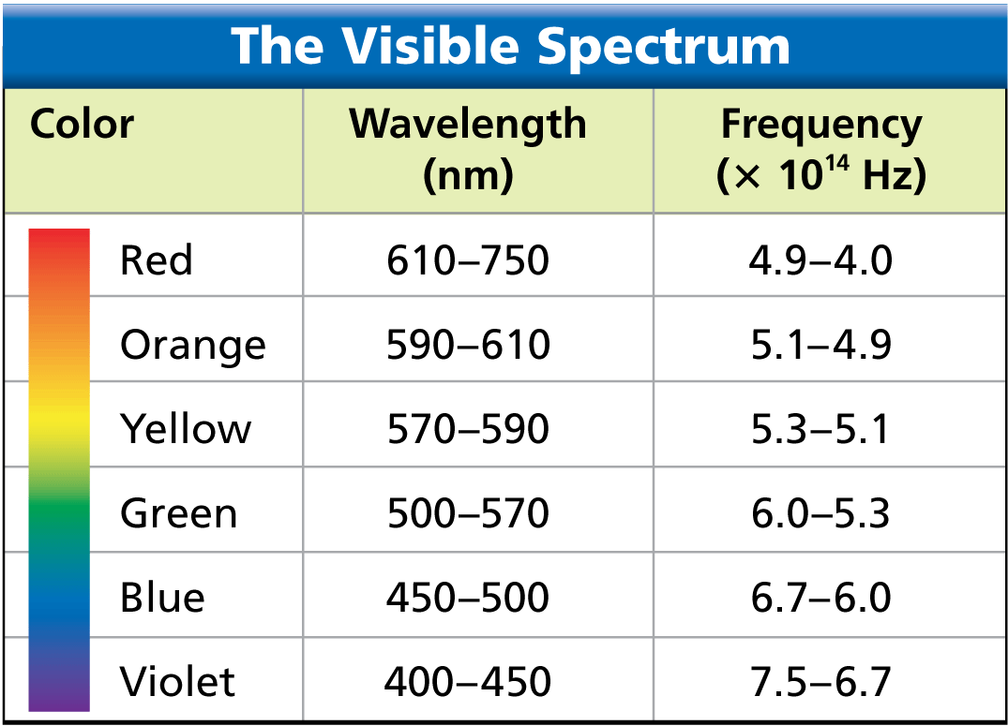
Light Color
Each color of light corresponds to a different range of wavelengths. The wavelengths of visible light are quite small. Wavelengths of red light, for example, are about one hundredth the thickness of a human hair.

Slide 15
UV (Ultraviolet)
Ultraviolet rays have applications in health and medicine, and in agriculture.
Ultraviolet rays vary from about 400 nm to about 4 nm.
Some exposure to ultraviolet rays helps your skin produce vitamin D, which helps the body absorb calcium from foods.
Excessive exposure can cause sunburn, wrinkles, skin cancer, and eye damage.
Ultraviolet rays are used to kill microorganisms. In winter, plant nurseries use ultraviolet lights to help plants grow.

Slide 16
X Rays
X-rays are used in medicine, industry, and transportation to make pictures of the inside of solid objects.
X-rays have very short wavelengths, from about 12 nm to about 0.005 nm.
X-rays have high energy and can penetrate matter that light cannot.
Too much exposure to X-rays can kill or damage living tissue.

Slide 17
X-Rays
Your teeth and bones absorb X-rays. X-ray photographs show softer tissue as dark, highly exposed areas. Bones and teeth appear white.
The lids on aluminum cans are sometimes inspected with X-rays to make sure they are sealed properly.
X-rays can be used to identify the contents of entire truck trailers.

Slide 18
Gamma (Cosmic)
Gamma rays are used in the medical field to kill cancer cells and make pictures of the brain, and in industrial situations as an inspection tool.
Gamma rays have the shortest wavelengths in the electromagnetic spectrum, about 0.005 nm or less.
They have the highest frequencies, the most energy, and the greatest penetrating ability of all the electromagnetic waves.
Exposure to tiny amounts of gamma rays is tolerable, but overexposure can be deadly.

Slide 19
Gamma Rays
Gamma rays are used in radiation therapy to kill cancer cells without harming nearby healthy cells.
Gamma rays are also used to make pictures of the human brain, with different levels of brain activity represented by different colors.
Pipelines are checked with machines that travel on the inside of a pipe, taking gamma ray pictures along the entire length.

Slide 20
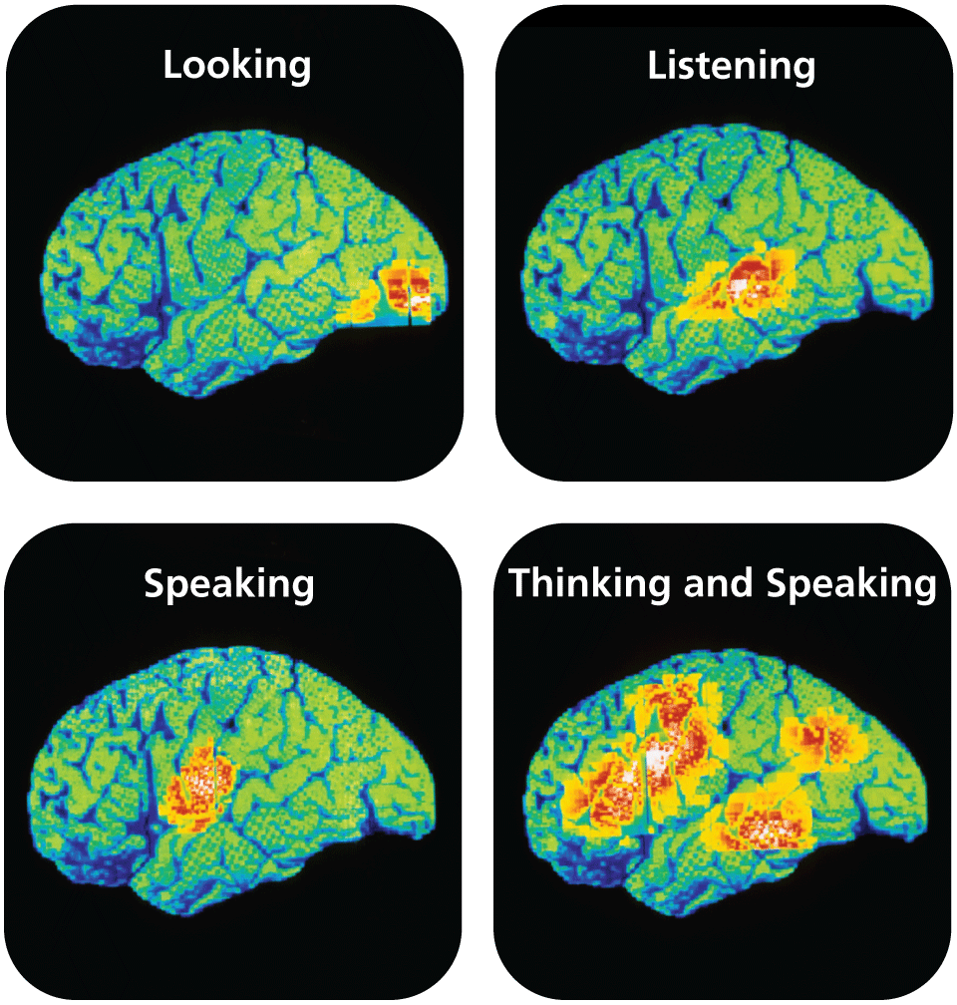
Gamma Rays
Gamma rays emitted by radioactive tracers in the brain are used to produce color-coded images. Areas of high activity show up in red.

