Slide 1
18.1
Electromagnetic Waves

Slide 2
Learning Objectives Section 18.1
Describe the characteristics of electromagnetic waves in a vacuum and how Michelson measured the speed of light.
Calculate the wavelength and frequency of an electromagnetic wave given its speed.
Describe the evidence for dual nature of electromagnetic radiation.
Describe how the intensity of light changes with distance from the light source.

Slide 3
What are electromagnetic waves?
Electromagnetic waves are transverse waves consisting of changing electric fields and changing magnetic fields.
Like mechanical waves, electromagnetic waves carry energy from place to place.
Electromagnetic waves differ from mechanical waves in how they are produced and how they travel.

Slide 4
How are electromagnetic waves produced?
Electromagnetic waves are produced by constantly changing electric fields and magnetic fields.
An electric field in a region of space exerts electric forces on charged particles. Electric fields are produced by electrically charged particles and by changing magnetic fields.
A magnetic field in a region of space produces magnetic forces. Magnetic fields are produced by magnets, by changing electric fields, and by vibrating charges.

Slide 5
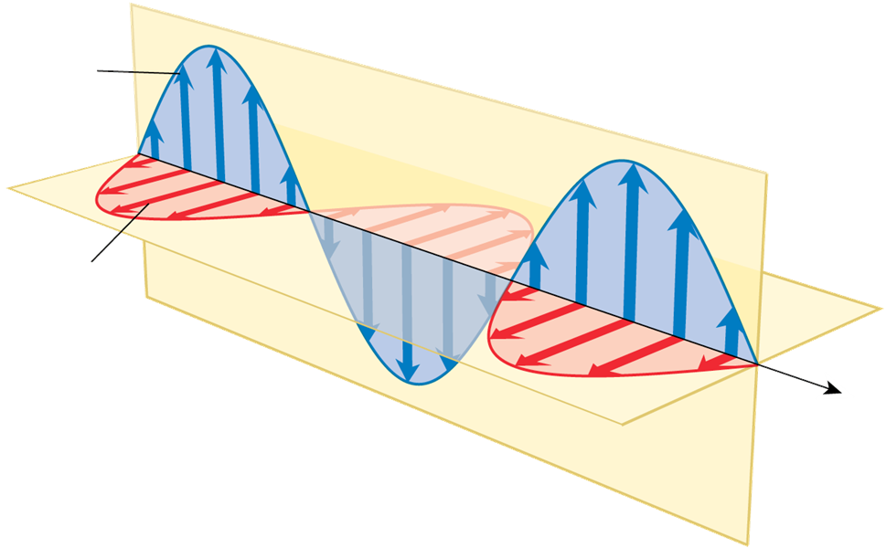
Transverse Waves
Electromagnetic waves are transverse waves because the fields are at right angles to the direction in which the wave travels.

Slide 6
How do electromagnetic waves travel?
Changing electric fields produce changing magnetic fields, and changing magnetic fields produce changing electric fields, so the fields regenerate each other.
Electromagnetic waves do not need a medium.
The transfer of energy by electromagnetic waves traveling through matter or across space is called electromagnetic radiation.

Slide 7
What is the speed of light (all electromagnetic waves)
In a vacuum (absent of anything) – the speed is 3.00 x 10⁸ m/s.

Slide 8
Michelson’s Experiment
In 1926, the American physicist Albert Michelson measured the speed of light more accurately than ever before.
Michelson placed an eight-sided rotating mirror and another mirror, that one stationary, about 35.4 kilometers apart.
Knowing the rotation speed that produced an uninterruped light beam, he was able to calculate the speed of light quite accurately.

Slide 9
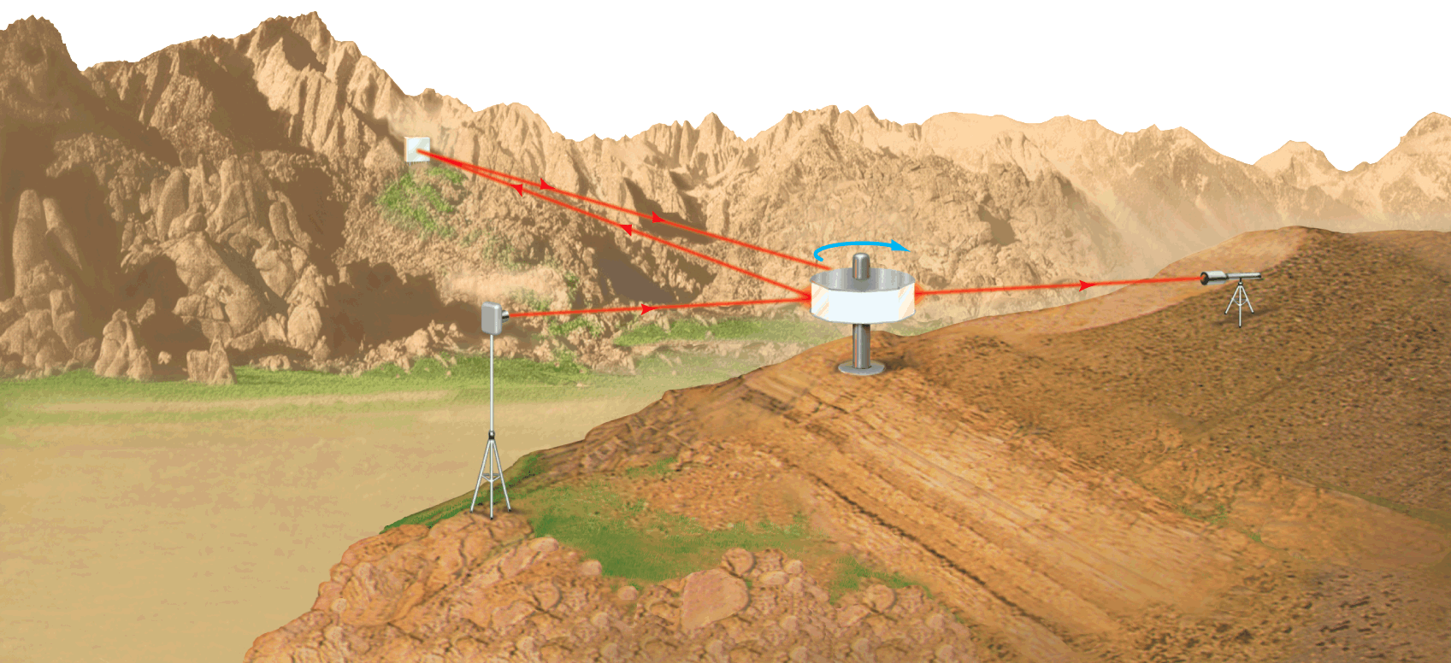
Michelson’s Experiment
Michelson timed a light beam as it traveled from one mountain to another and back again. His experiment measured the speed of light more accurately than it had been measured before.
Mt. San Antonio
Mirror
35.4 km
Telescope
Light Source
Octagonal Rotating Mirror
Mt. Wilson

Slide 10
How do electromagnetic waves differ.
Electromagnetic waves vary in frequency and wavelengths.
The speed of an electromagnetic wave is the product of its wavelength and its frequency.
The speed of electromagnetic waves in a vacuum is constant, so the wavelength is inversely proportional to the frequency.
As the wavelength increases, the frequency decreases.
Formula:

Slide 11
Practice Problem
A radio station broadcasts a radio wave with a wavelength of 3.0 meters. What is the frequency of the wave?

Slide 12
Wave or Particle?
Electromagnetic radiation behaves sometimes like a wave and sometimes like a stream of particles.
Scientists know that electromagnetic radiation travels as a wave. Scientists also have evidence that electromagnetic radiation behaves like a stream of particles.
So which is light, wave or particle?
It is both.

Slide 13
Evidence for the Wave & Particle Model
The fact that light casts a shadow has been used as evidence for both the wave model of light and the particle model of light

Slide 14
More Evidence for the wave model
A beam of light passes first through a single slit and then through a double slit.
Where light from the two slits reaches a darkened screen, there are alternating bright and dark bands.
The bands are evidence that the light produces an interference pattern.
Interference occurs only when two or more waves overlap.

Slide 15
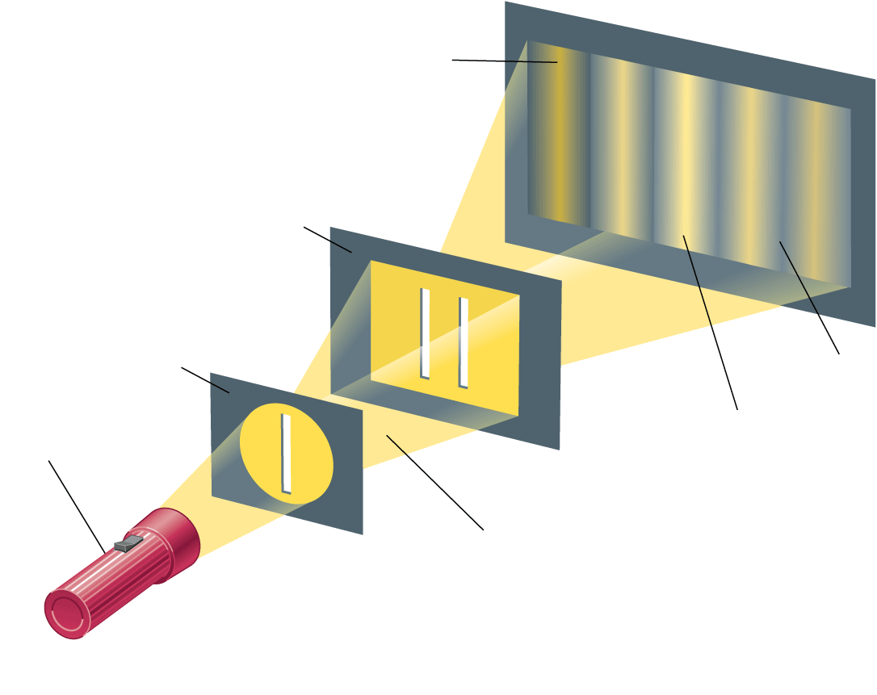
Evidence
Interference pattern appears on screen.
When light passes through a single slit and then a double slit, it produces an interference pattern.
Card with two slits
Card with one slit
Dark bands show destructive interference.
Light source
Bright bands show constructive interference.
Light from single slit produces coherent light at second card.

Slide 16
Now evidence for the particle model
When dim blue light hits the surface of a metal such as cesium, an electron is emitted.
A brighter blue light causes even more electrons to be emitted.
Red light, no matter how bright it is, does not cause the emission of any electrons from this particular metal

Slide 17
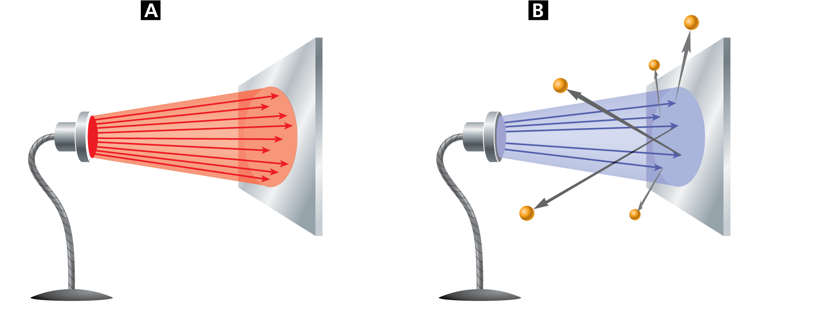
Now wave or particle
Red light or infrared rays, no matter how bright, does not cause electrons to be emitted from this metal surface.
When blue light or ultraviolet rays strike the metal surface, electrons are emitted, even if the light is dim.
Bright red light or infrared rays
No electrons are emitted.
Dim blue light or ultraviolet rays
Electrons are emitted.
Metal plate
Metal plate

Slide 18
What is intensity of light?
The closer you are to a source of light, the brighter the light appears.
Photons travel outward from a light source in all directions.
Near the light source, the photons spread through a small area, so the light is intense.
Farther from the source, the photons spread over a larger area
The intensity of light decreases as photons travel farther from the source

Slide 19
Intensity
Intensity is the rate at which a wave’s energy flows through a given unit of area. A wave model also explains how intensity decreases.
As waves travel away from the source, they pass through a larger and larger area.
The total energy does not change, so the wave’s intensity decreases.

Slide 20
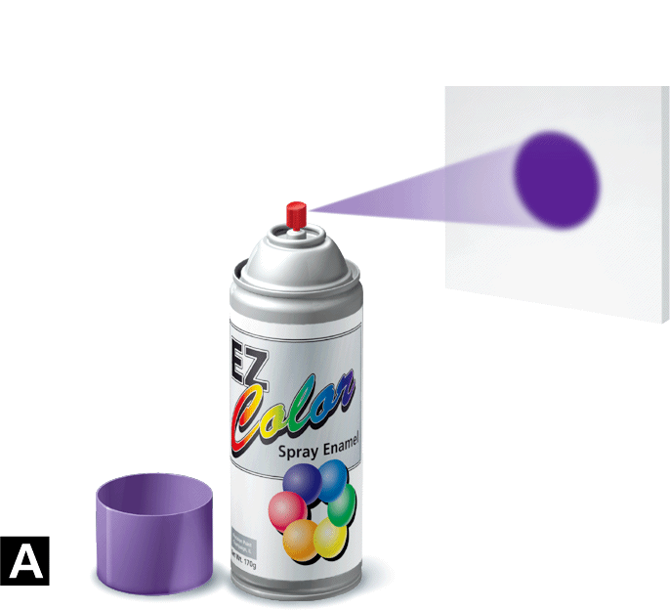
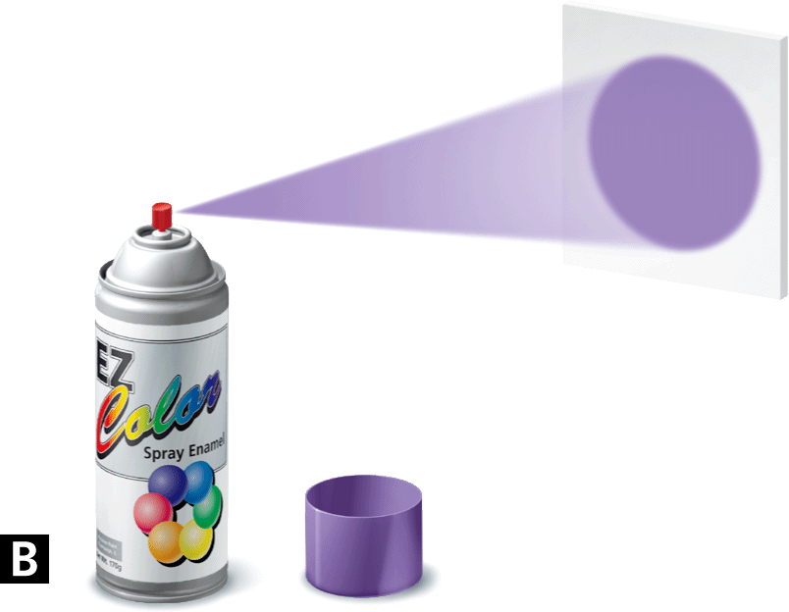
Intensity
The closer you are to a surface when you spray paint it, the smaller the area the paint covers, and the more intense the paint color looks.

