Slide 1
17.4– Sound and Hearing

Slide 2
Learning Objectives Section 17.4
Describe the properties of sound waves and explain how sound is produced and reproduced
Describe how sound waves behave in application such as ultrasound and music.
Explain how relative motion determines the frequency of sound an observer hears
Analyze the function of the main regions of the human ear.

Slide 3
What are the main properties of sound?
Many behaviors of sound can be explained using a few properties—speed, intensity and loudness, and frequency and pitch
Sound waves are longitudinal waves—compressions and rarefactions that travel through a medium.

Slide 4
Speed in a Sound Wave
It takes time for sound to travel from place to place.
The speed of sound varies in different media. In dry air at 20°C, the speed of sound is 342 meters per second.

Slide 5
Properties of Sound Waves
In general, sound waves travel fastest in solids, slower in liquids, and slowest in gases.
Particles in a solid tend to be closer together than particles in a liquid or a gas.
The speed of sound depends on many factors, including the density of the medium and how elastic the medium is.

Slide 6
Intensity and Loudness
Intensity is the rate at which a wave’s energy flows through a given area.
Sound intensity depends on both the wave’s amplitude and the distance from the sound source.
The decibel (dB) is a unit that compares the intensity of different sounds
For every 10-decibel increase, the sound intensity increases tenfold.
A 0-decibel sound can just barely be heard.
A 20-decibel sound has 100 times more energy per second than a 0-decibel sound.
A 30-decibel sound delivers 1000 times more energy per second than a 0-decibel sound.

Slide 7
Loudness and Intensity
Lengthy exposure to sounds more intense than 90 decibels can cause hearing damage.

Slide 8
Just Loudness
Loudness is a physical response to the intensity of sound, modified by physical factors.
The loudness depends on sound intensity.
Loudness also depends on factors such as the health of your ears and how your brain interprets sound waves.

Slide 9
Frequency & Pitch
The frequency of a sound wave depends on how fast the source of the sound is vibrating.
The air in the tubing of brass instruments forms a standing wave. Longer tubing makes a standing wave with a longer wavelength and a lower frequency.

Slide 10
Frequency & Pitch
The French horn can produce lower notes than the trumpet because it can make a longer tube for a standing wave.

Slide 11
What is pitch?
Pitch is the frequency of a sound as you perceive it.
High-frequency sounds have a high pitch, and low-frequency sounds have a low pitch.
Pitch also depends on other factors such as your age and the health of your ears.

Slide 12
What is an ultrasound?
Ultrasound is used in a variety of applications, including sonar and ultrasound imaging.
Most people hear sounds between 20 hertz and 20,000 hertz.
Infrasound is sound at frequencies lower than most people can hear.
Ultrasound is sound at frequencies higher than most people hear.

Slide 13
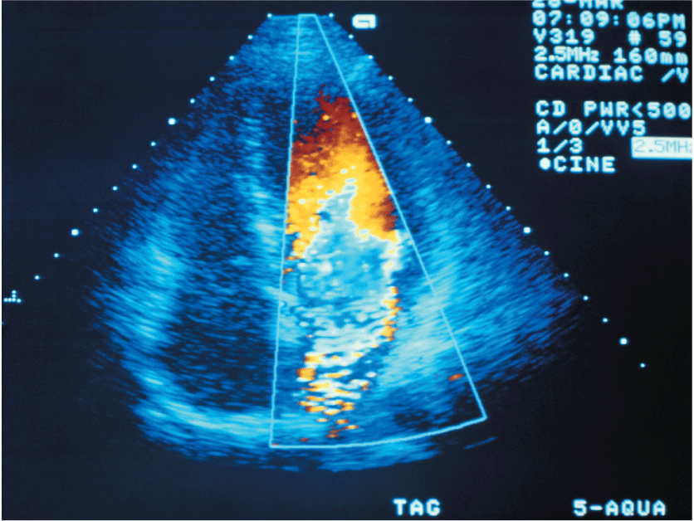
Ultrasound
Ultrasound can be used to make images of the heart.

Slide 14
What is the Doppler Effect?
The Doppler Effect is when a source of sound approaches, an observer hears a higher frequency. When the sound source moves away, the observer hears a lower frequency.
The Doppler effect is a change in sound frequency caused by motion of the sound source, motion of the listener, or both.

Slide 15
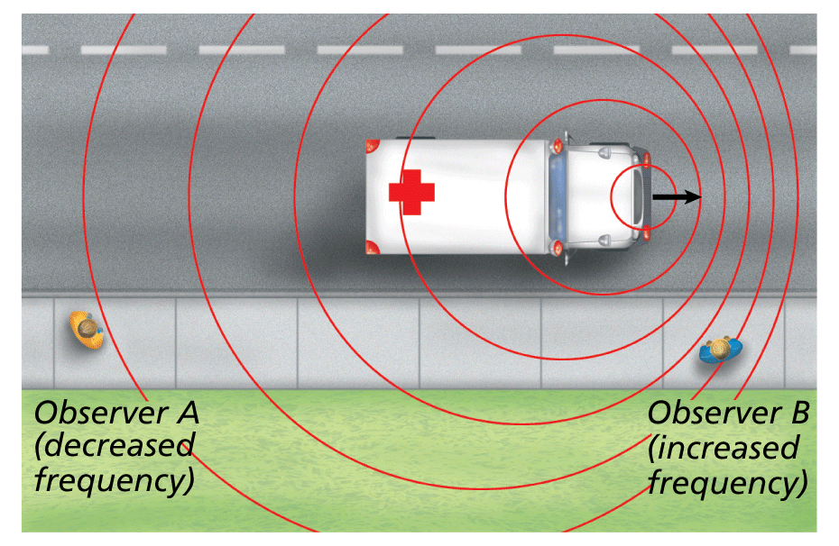
Doppler Effect
Observer A hears a lower-pitch sound than observer B because the wave fronts are farther apart for observer A.

Slide 16
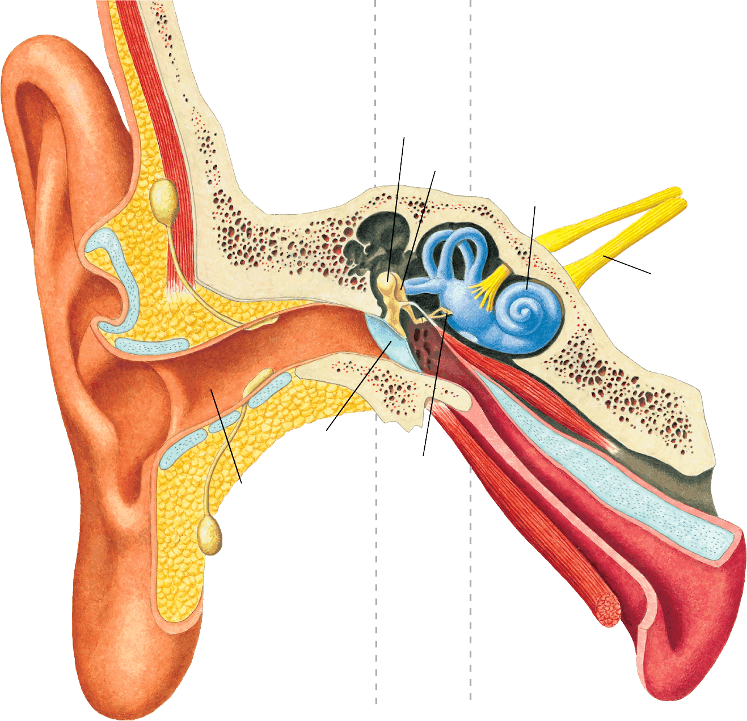
Hearing and the Ear
Outer Ear
Middle Ear
Inner Ear
Your ear is a complex system that consists of three main regions—the outer ear, the middle ear, and the inner ear.
Hammer
Anvil
Cochlea
Auditory Nerve
Eardrum
Stirrup
Ear canal

Slide 17
Outer Ear
Outer Ear
The part of the ear you can see funnels sound waves down the ear canal, a tunnel about 2.5 cm long.
Sound waves strike the eardrum, a tightly stretched membrane between the outer and middle ear.
The eardrum vibrates at the same frequency as the sound waves striking it.

Slide 18
Middle Ear
The middle ear contains three tiny bones—the hammer, the anvil, and the stirrup. The three bones act as a lever system to amplify the motion of the eardrum.
When the eardrum vibrates, the hammer vibrates at the same frequency.
The hammer strikes the anvil.
The anvil moves the stirrup back and forth

Slide 19
Inner Ear
Inner Ear
Vibrations from the stirrup travel into the cochlea, a spiral-shaped canal filled with fluid.
The inside of the cochlea is lined with thousands of nerve cells with tiny hair-like projections.
As the fluid in the cochlea vibrates, the projections sway back and forth and send electrical impulses to the brain.

Slide 20
How do musical instruments vary pitch?
Most musical instruments vary pitch by changing the frequency of standing waves.
Musical instruments can produce a wide variety of sounds.
In a wind instrument, holes are closed using fingers or valves to change the length of the standing sound wave.
For some stringed instruments, musicians change the length of the strings by pressing down with their fingers.
Other instruments use a fixed set of strings of different lengths.

Slide 21
More on Music
Musical instruments can produce a wide variety of sounds.
In a wind instrument, holes are closed using fingers or valves to change the length of the standing sound wave.
For some stringed instruments, musicians change the length of the strings by pressing down with their fingers.
Other instruments use a fixed set of strings of different lengths.

Slide 22
Resonance
Resonance is the response of a standing wave to another wave of the same frequency. Musical instruments often use resonance to amplify sound.
One wave can “push” another wave to a higher amplitude.
Resonance can produce a dramatic increase in amplitude.

Slide 23
Reverberations
Sound-absorbing tiles in this auditorium reduce unwanted reflections. The curved reflecting panels above the stage help gather and direct sound waves toward the audience

