Slide 1
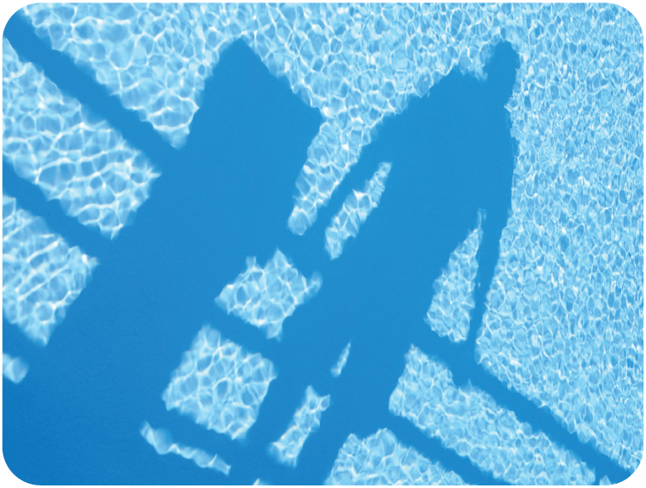
17.3– Behavior of Waves

Slide 2
Learning Objectives Section 17.3
Describe how reflection, refraction, diffraction and interference affect waves.
State a rule that explains refraction of waves as it passes from one medium into another.
Identify factors that affect the amount of refraction, diffraction or interference.
Distinguish between constructive and destructive interference and explain how standing wave forms.

Slide 3
What is reflection?
Reflection occurs when a wave bounces off a surface that it cannot pass through.
Reflection does not change the speed or frequency of a wave, but the wave can be flipped upside down.

Slide 4
What is refraction?
Refraction is the bending of a wave as it enters a new medium at an angle
What causes the refraction of a wave when it enters a new medium?
When a wave enters a medium at an angle, refraction occurs because one side of the wave moves more slowly than the other side

Slide 5
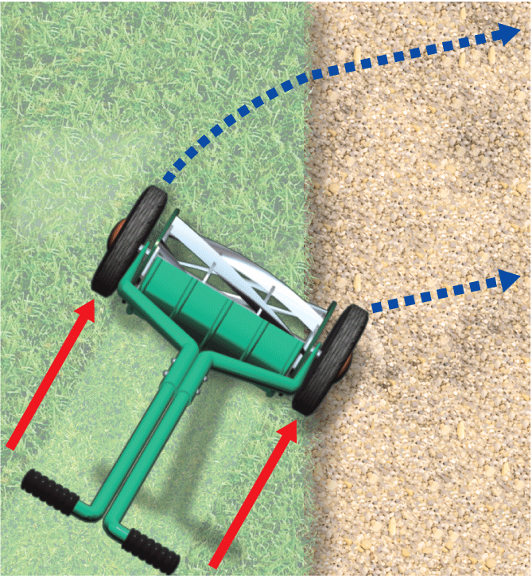
Refraction
Grass
Gravel
A lawnmower turns when it is pushed at an angle from the grass onto the gravel.
The wheel on the gravel slows down, but the other wheel is still moving at a faster speed on the grass.
Left wheel is still rolling faster on grass.
Direction changes.
Mower pivots because the right wheel moves more slowly when it reaches gravel.

Slide 6
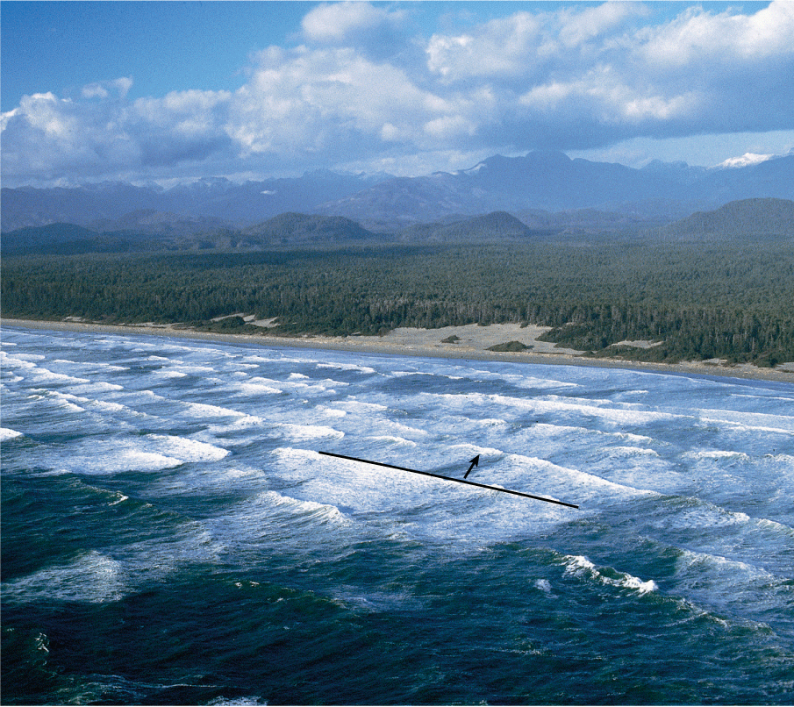
Refraction
As an ocean wave approaches the shore at an angle, the wave bends, or refracts, because one side of each wave front slows down before the other side does.

Slide 7
Refraction
An ocean wave refracts as it flows into a shallow area.
The shallower water can be considered a new medium.
As one side of each wave enters shallower water before the other, that side slows down and the wave bends.
If a wave front is parallel to the shoreline, the wave enters the shallower water all at once, and there is no refraction.

Slide 8
What is diffraction?
Diffraction is the bending of a wave as it moves around an obstacle or passes through a narrow opening.
A wave diffracts more if its wavelength is large compared to the size of an opening or obstacle.

Slide 9
Diffraction
Water waves spread out as they pass through a narrow opening.
The pattern produced is very similar to the circular ripples you see when a pebble is tossed into a pond.
Diffraction also occurs when waves bend around an obstacle.
The larger the wavelength is compared to the size of the opening or obstacle, the more the wave diffracts

Slide 10
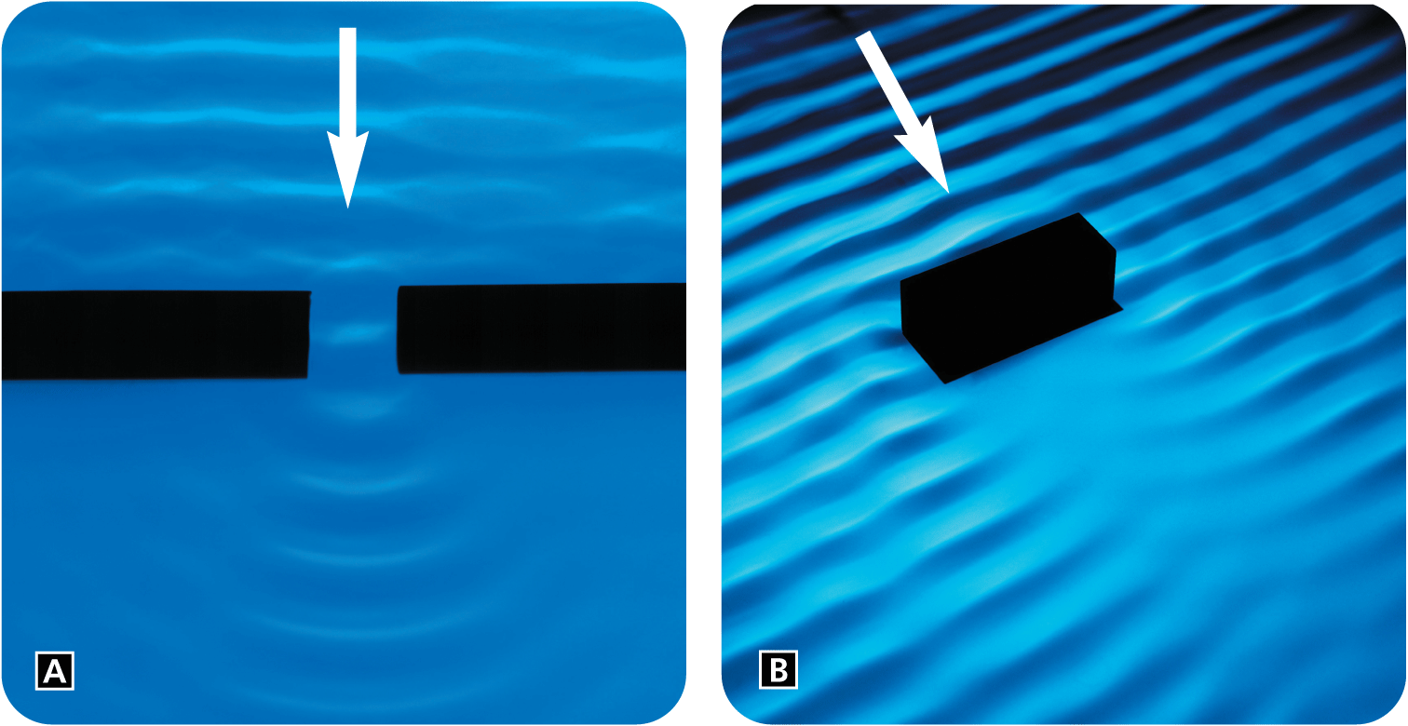
Diffraction
This wave diffracts, or spreads out, after it passes through a narrow opening.
Diffraction also occurs when a wave encounters an obstacle.

Slide 11
What is interference?
Interference occurs when two or more waves overlap and combine together.
There are two types of interference:
Constructive
Destructive

Slide 12
More on Interference
When waves collide, they can occupy the same region of space and then continue on.
Constructive interference occurs when two or more waves combine to produce a wave with a larger displacement.
Destructive interference occurs when two or more waves combine to produce a wave with a smaller displacement.

Slide 13
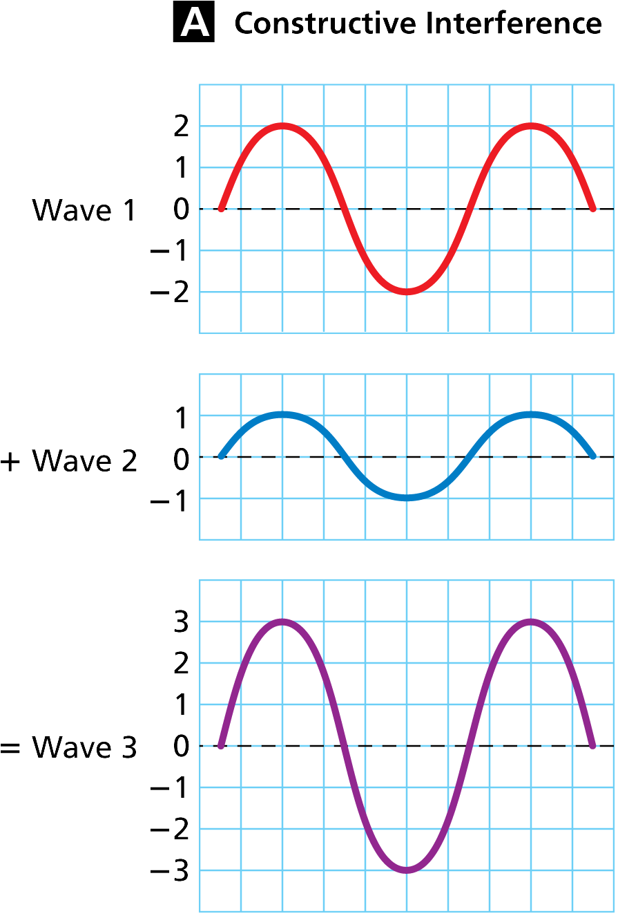
Constructive Interference
Two waves with equal frequencies travel in opposite directions.
When a crest meets a crest, the result is a wave with an increased amplitude.

Slide 14
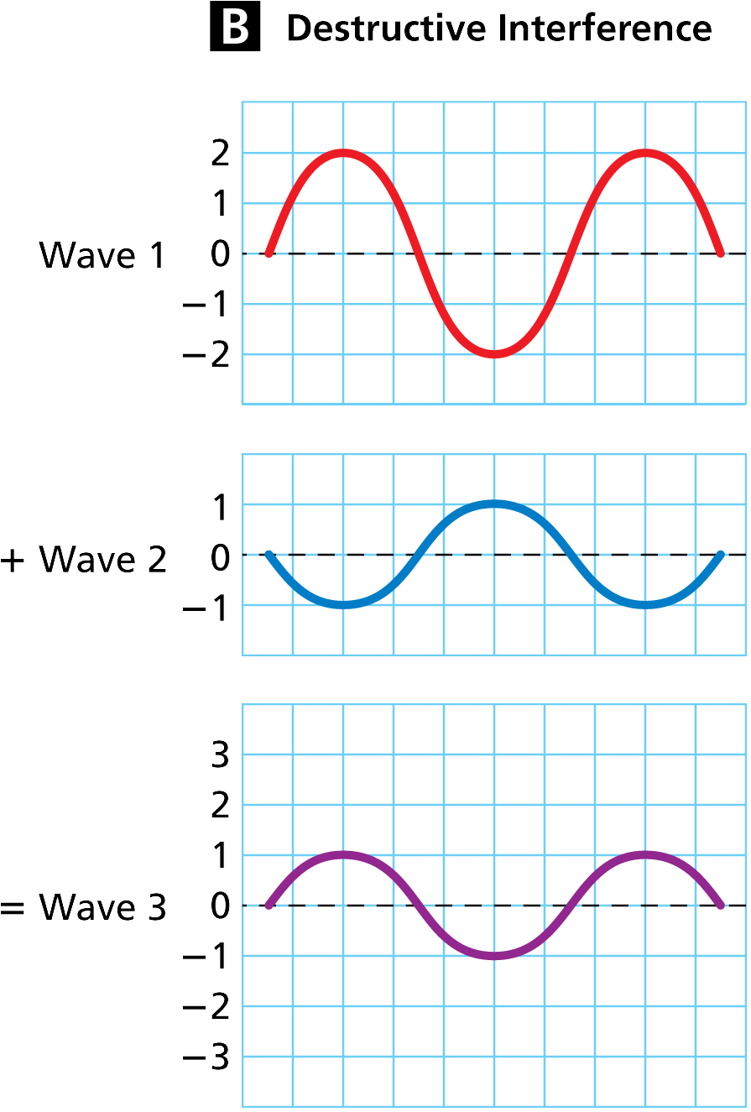
Destructive Interference
Two waves with equal frequencies travel in opposite directions.
When a crest meets a trough, the result is a wave with a reduced amplitude.

Slide 15
What is a standing wave?
A standing wave is a wave that appears to stay in one place—it does not seem to move through the medium.
A standing wave forms only if half a wavelength or a multiple of half a wavelength fits exactly into the length of a vibrating cord.
Interference occurs as the incoming waves pass through the reflected waves.
At certain frequencies, interference between a wave and its reflection can produce a standing wave.

Slide 16
Node vs Antinode on a standing wave
A node is a point on a standing wave that has no displacement from the rest position. At the nodes, there is complete destructive interference between the incoming and reflected waves.
An antinode is a point where a crest or trough occurs midway between two nodes.

Slide 18
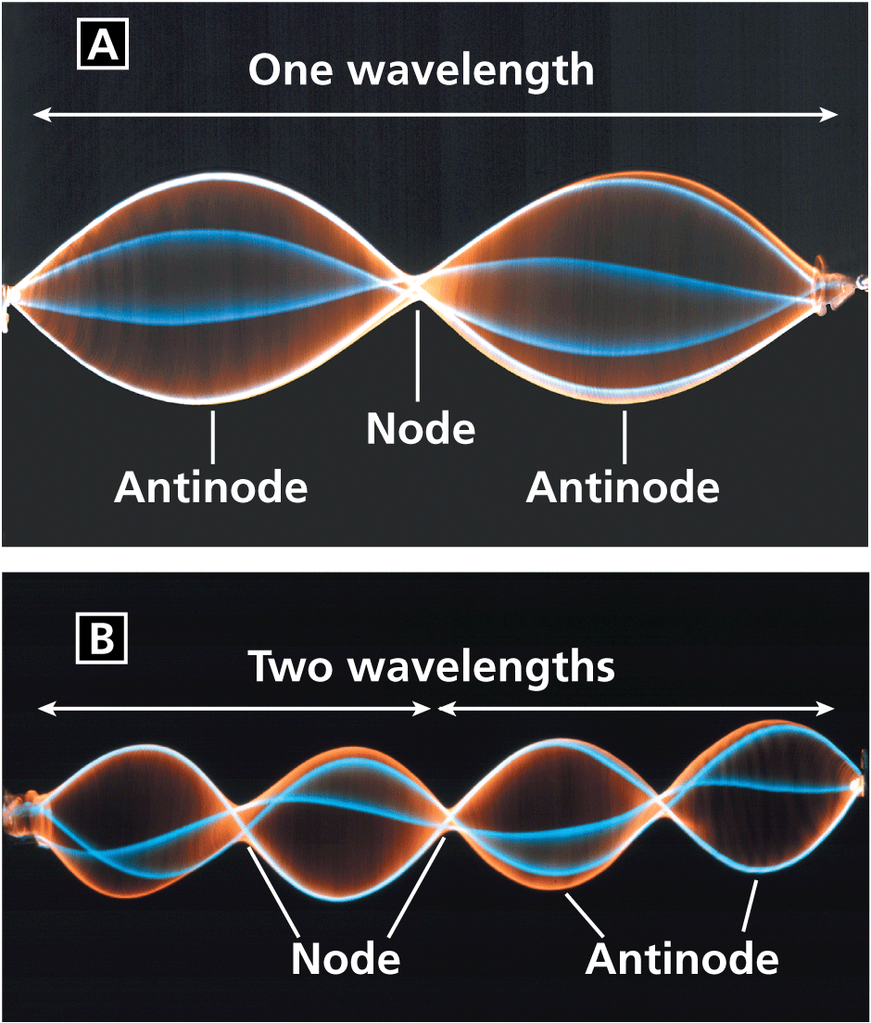
Node Vs Antinode
These photos show standing waves for two different frequencies.
One wavelength equals the length of the cord.
Two wavelengths equal the length of the cord.

