Slide 1
17.2 – Properties of Mechanical Waves

Slide 2
Learning Objectives Section 17.2
Define frequency, period wavelength and wave speed.
Solve equations relating wave speed to wavelength and frequency or period.
Describe how to measure amplitude and relate amplitude to the energy of a wave.

Slide 3
What is the frequency of a wave?
Any periodic motion has a frequency, which is the number of complete cycles in a given time
A wave’s frequency equals the frequency of the vibrating source producing the wave.

Slide 4
So then what is periodic motion?
Any motion that repeats at regular time intervals is called periodic motion.
The time required for one cycle is called the period.
Frequency is the number of complete cycles in a given time.
Frequency is measured in cycles per second, or hertz (Hz).

Slide 5
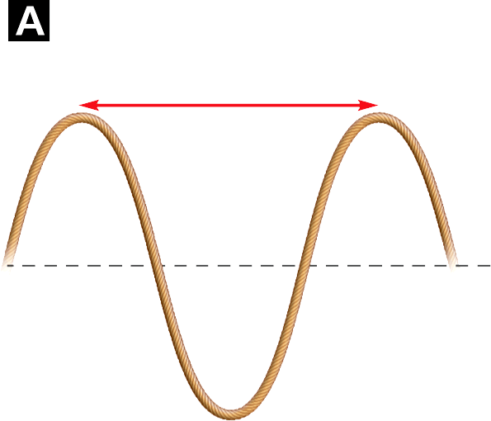
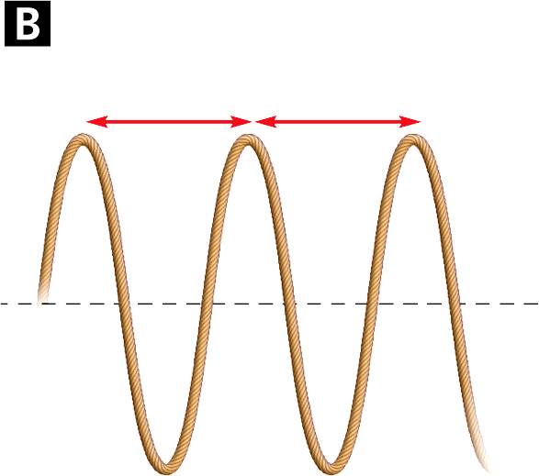
Frequency and Period
Frequency = 1.0 hertz One cycle per second
A wave vibrating at one cycle per second has a frequency of 1.0 Hz.
A wave vibrating at two cycles per second has a frequency of 2.0 Hz.
Frequency = 2.0 hertz Two cycles per second

Slide 6
What are wavelengths and how are they related to frequency?
Wavelength is the distance between a point on one wave and the same point on the next cycle of the wave.
Increasing the frequency of a wave decreases its wavelength. (Inverse relationship)
For a transverse wave, wavelength is measured between adjacent crests or between adjacent troughs.
For a longitudinal wave, wavelength is the distance between adjacent compressions or rarefactions.

Slide 7
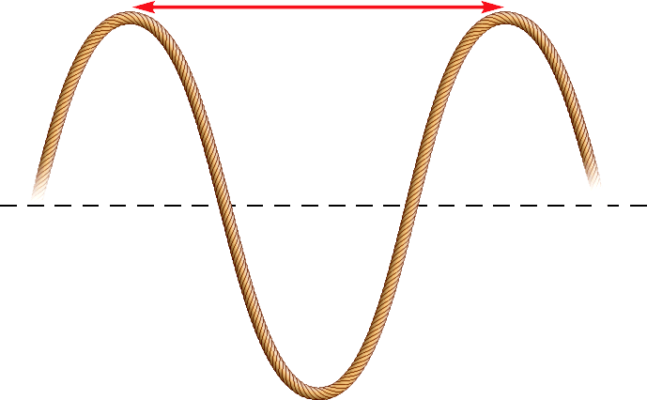
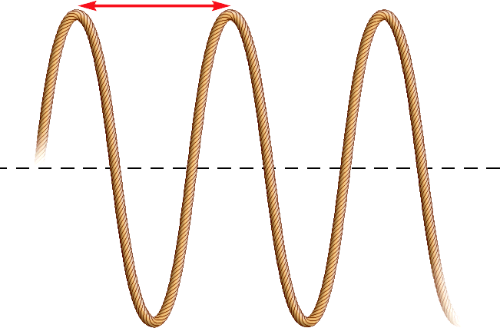
Wavelength
Wavelength can be measured from any point on a wave to the same point on the next cycle of the wave.
Long wavelength
Short wavelength
Rest position

Slide 8
How are frequency, wavelength and speed related?
If you assume that waves are traveling at a constant speed, then wavelength is inversely proportional to frequency.
When the wavelength is in meters, and the frequency is in hertz, the units for speed are meters per second.
The speed of a wave is also calculated by dividing its wavelength by its period.

Slide 9
Practice Problem – Wave Equation
One end of a rope is vibrated to produce a wave with a wavelength of 0.25 meter. The frequency of the wave is 3.0 hertz. What is the speed of the wave?

Slide 10
More on Wave Speed
The speed of a wave can change if it enters a new medium, or if variables such as pressure and temperature change.
For many kinds of waves, the speed of the waves is roughly constant for a range of different frequencies.
The wave with the lower frequency has a longer wavelength.

Slide 11
Amplitude Again & Energy
The amplitude of a wave is the maximum displacement of the medium from its rest position.
The more energy a wave has, the greater the amplitude.
The amplitude of a transverse wave is the distance from the rest position to a crest or a trough.
It takes more energy to produce a wave with higher crests and deeper troughs.

Slide 12
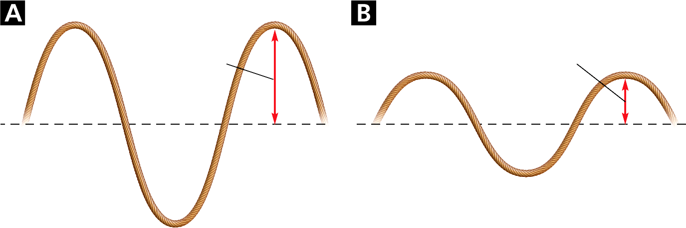
Amplitude
The more energy a wave has, the greater is its amplitude.
High amplitude
Low amplitude
Rest position

Slide 13
Longitudinal Amplitude
The amplitude of a longitudinal wave is the maximum displacement of a point from its rest position.
The more energy the wave has, the more the medium will be compressed or displaced.

