Slide 1
 | 4.2 The Structure of the Atom
Subatomic Particles Proton Electrons Neutrons Size Comparing Subatomic Particles Proton mass Neutron mass Electron mass | Proton, Neutrons and Electrons Rutherford; Found inside the nucleus (center); +1 charge Thomson; Found in the space outside the nucleus; -1 charge Chadwick; Found in the space inside the nucleus; 0 charge Most of the size of the atom is made up of the proton and neutrons. Electrons contribute very little: If proton & neutrons are roughly 1 (same size) then the electron is 1/1836 of a proton. (very small) p⁺, e⁻, n⁰ → are the symbols; can be distinguished by where they are located; size and charge. 1.674 x 10⁻²⁴ g 1.675 x 10⁻²⁴ g 9.11 x 10⁻²⁸ g

Slide 2
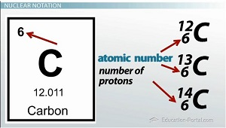
 | 4.2 Structure of the Atom
Atomic Number Electrically Balanced Mass Number Mass Notation | Any atom of any given element has the same number of protons. That is how to distinguish elements from one another. Ex: 1 protons= Hydrogen (H); 12 protons = Magnesium (Mg) Because atoms are “neutral” electrically balanced the number of negative charges (electrons) must equal the number of protons; Ex: Hydrogen (H) has 1 protons so it has to have 1 electrons Magnesium (Mg) has 12 proton, so it has to have 12 electrons Is the total number of neutrons and protons (inside the nucleus) Ex: Carbon has an atomic number of 6 which means 6 p⁺; is also can have 8 neutrons → mass number is 14 Mass number = p⁺ + n⁰

Slide 3
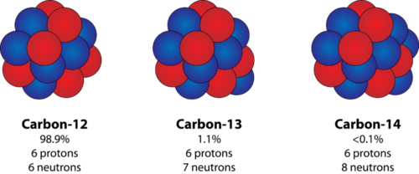
 | 4.2 Structure of the Atom
Isotopes Isotopes Notation | Another – Carbon-14 Which means carbon always has 6 Proton; but this carbon has 8 neutrons Carbon-13; still always has 6 proton but this carbon has 7 neutrons All atoms of the same element must have the same number of proton; but they can have a different number of neutrons inside the nucleus So they have the same atomic number but different mass number Or

