Slide 1
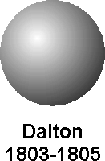
 | Early Atomic Theory
Democritus 400 bc Aristotle 384 bc Dalton’s Theory 1766 | All matter consists of small particles that could not be divided Atomos = Atoms = uncuttable Democritus student; 4 elements: Earth, Water, Air & Fire Most people accepted for 2000 years. Evidence Dalton used → all compounds had a fixed ratio ex: MgO All matter is made up of individual particles All atoms of the same element have the same mass Compounds containing more than one element have a fixed ratio Compounds always form the same way Later scientist revised “theory”

Slide 3
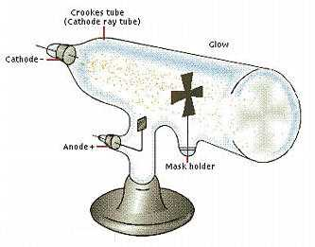
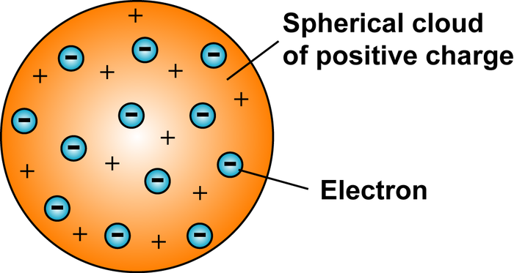
 | Early Atomic Theory
Crooke’s Tube Thomson 1897-1899 Rutherford “Gold Foil” 1905 | Early CRT (Cathode Ray Tube) used to discover the electron. The stream of negatively charge particles travel from the cathode (-) side to the anode (+) side. Uses the CRT and uses negatively and positive charged plate to show the stream of particles are negatively charged. (deflected from the negative side to the positive side of plate. “plum pudding model” Alpha particles (+ charged) shoots them at a piece of gold foil (very thin) and see that some are deflected back → thus meaning that there is a small dense “nucleus” of positively charged materials.

Slide 4
 | Early Atomic Theory continued
Thomson 1897-1899

